Slide 1
2022/2023 ACADEMIC YEAR
FACULTY OF ART AND DESIGN YEARLY REPORT

Slide 2

AGENDA
GIFT FUND 100 ARTWORKS BY STUDENTS
EXHIBITIONS
HIGHSCHOOL VISITS AND STUDENTS CLASS ACTIVITIES
SYMPOSIUMS AND CONFERENCES

Slide 3
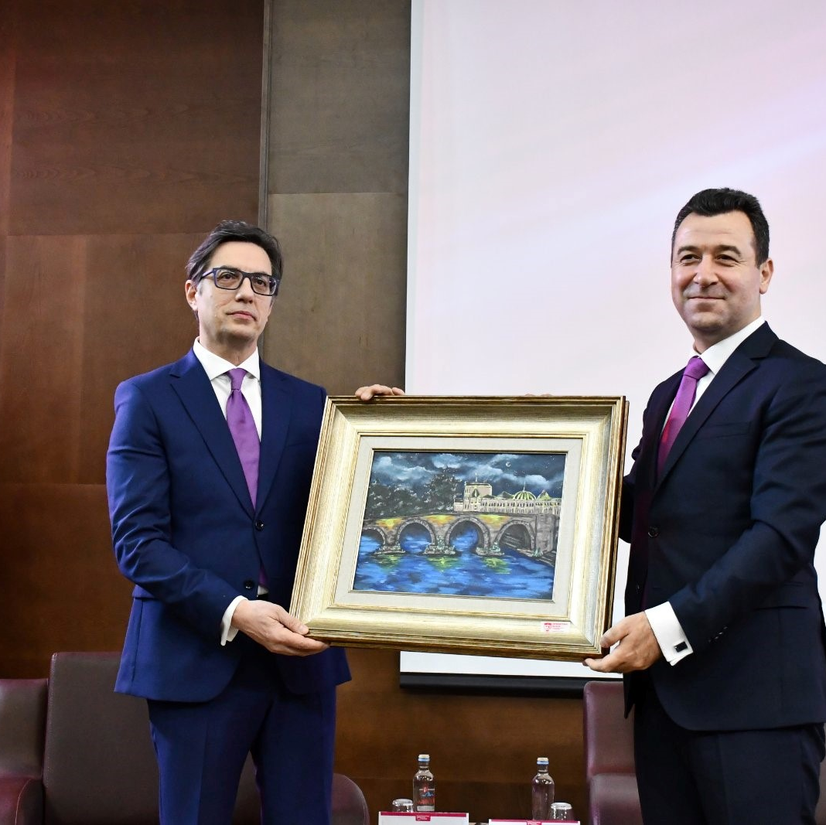
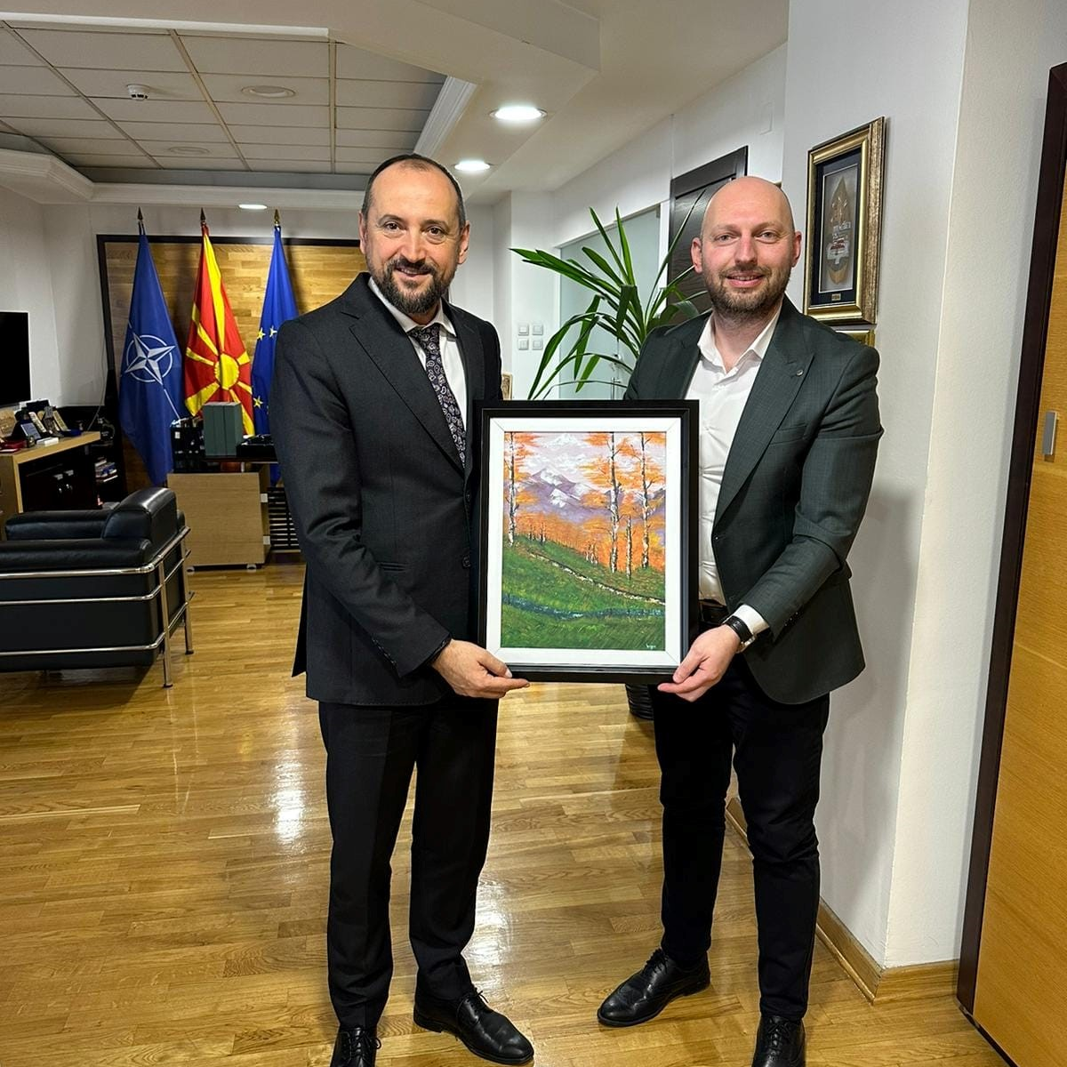
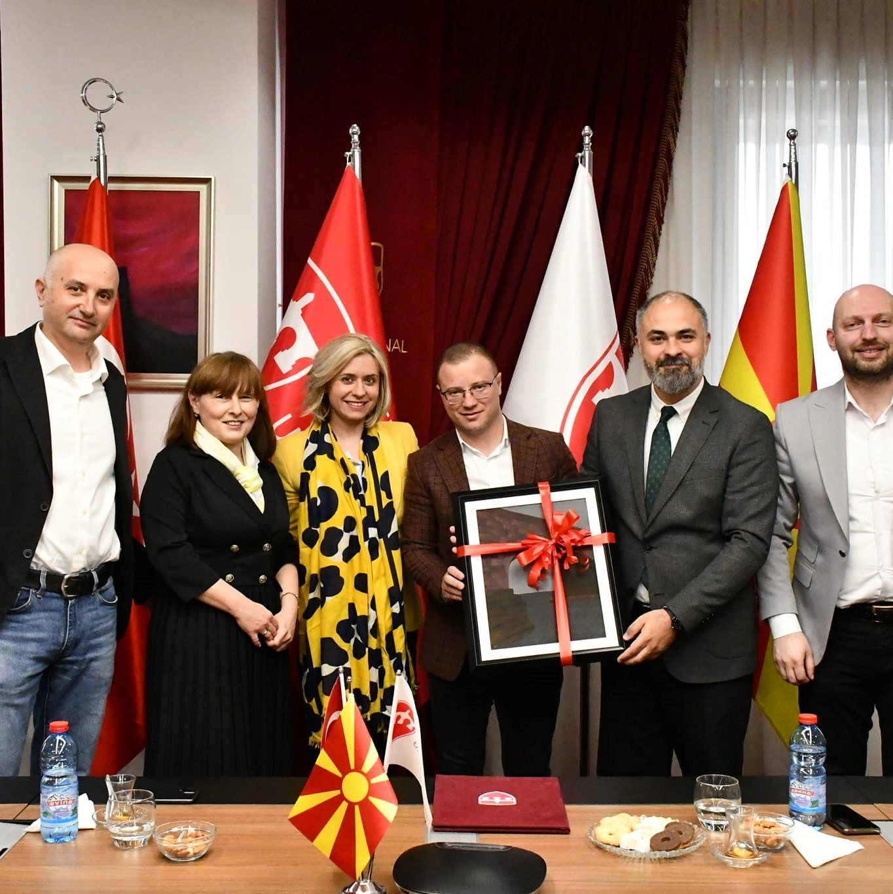
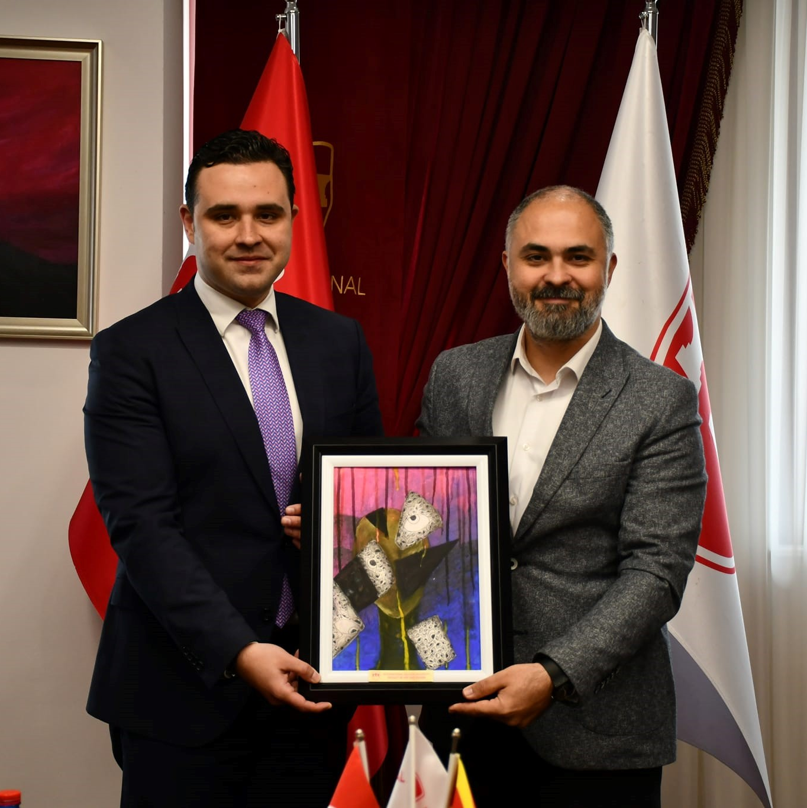
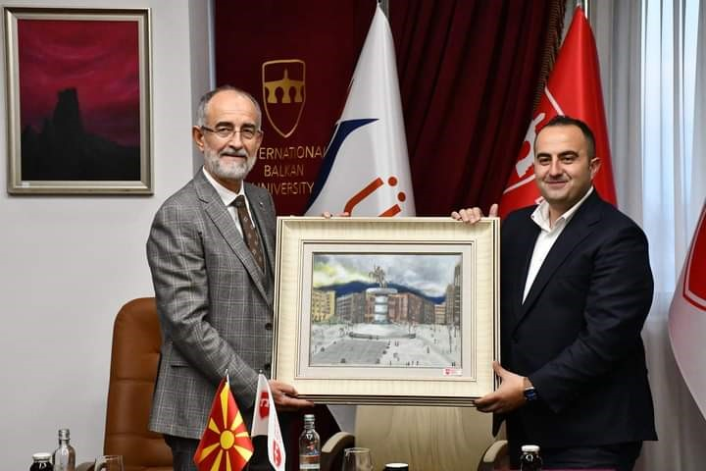
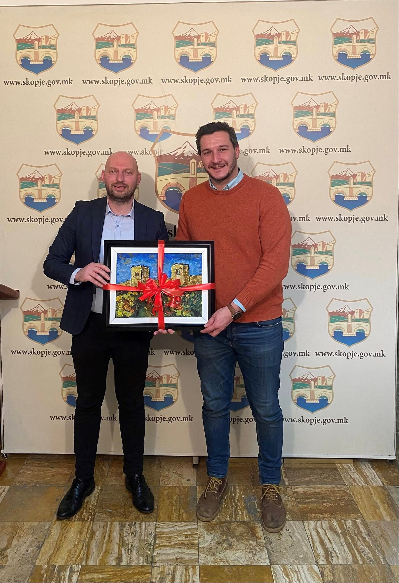
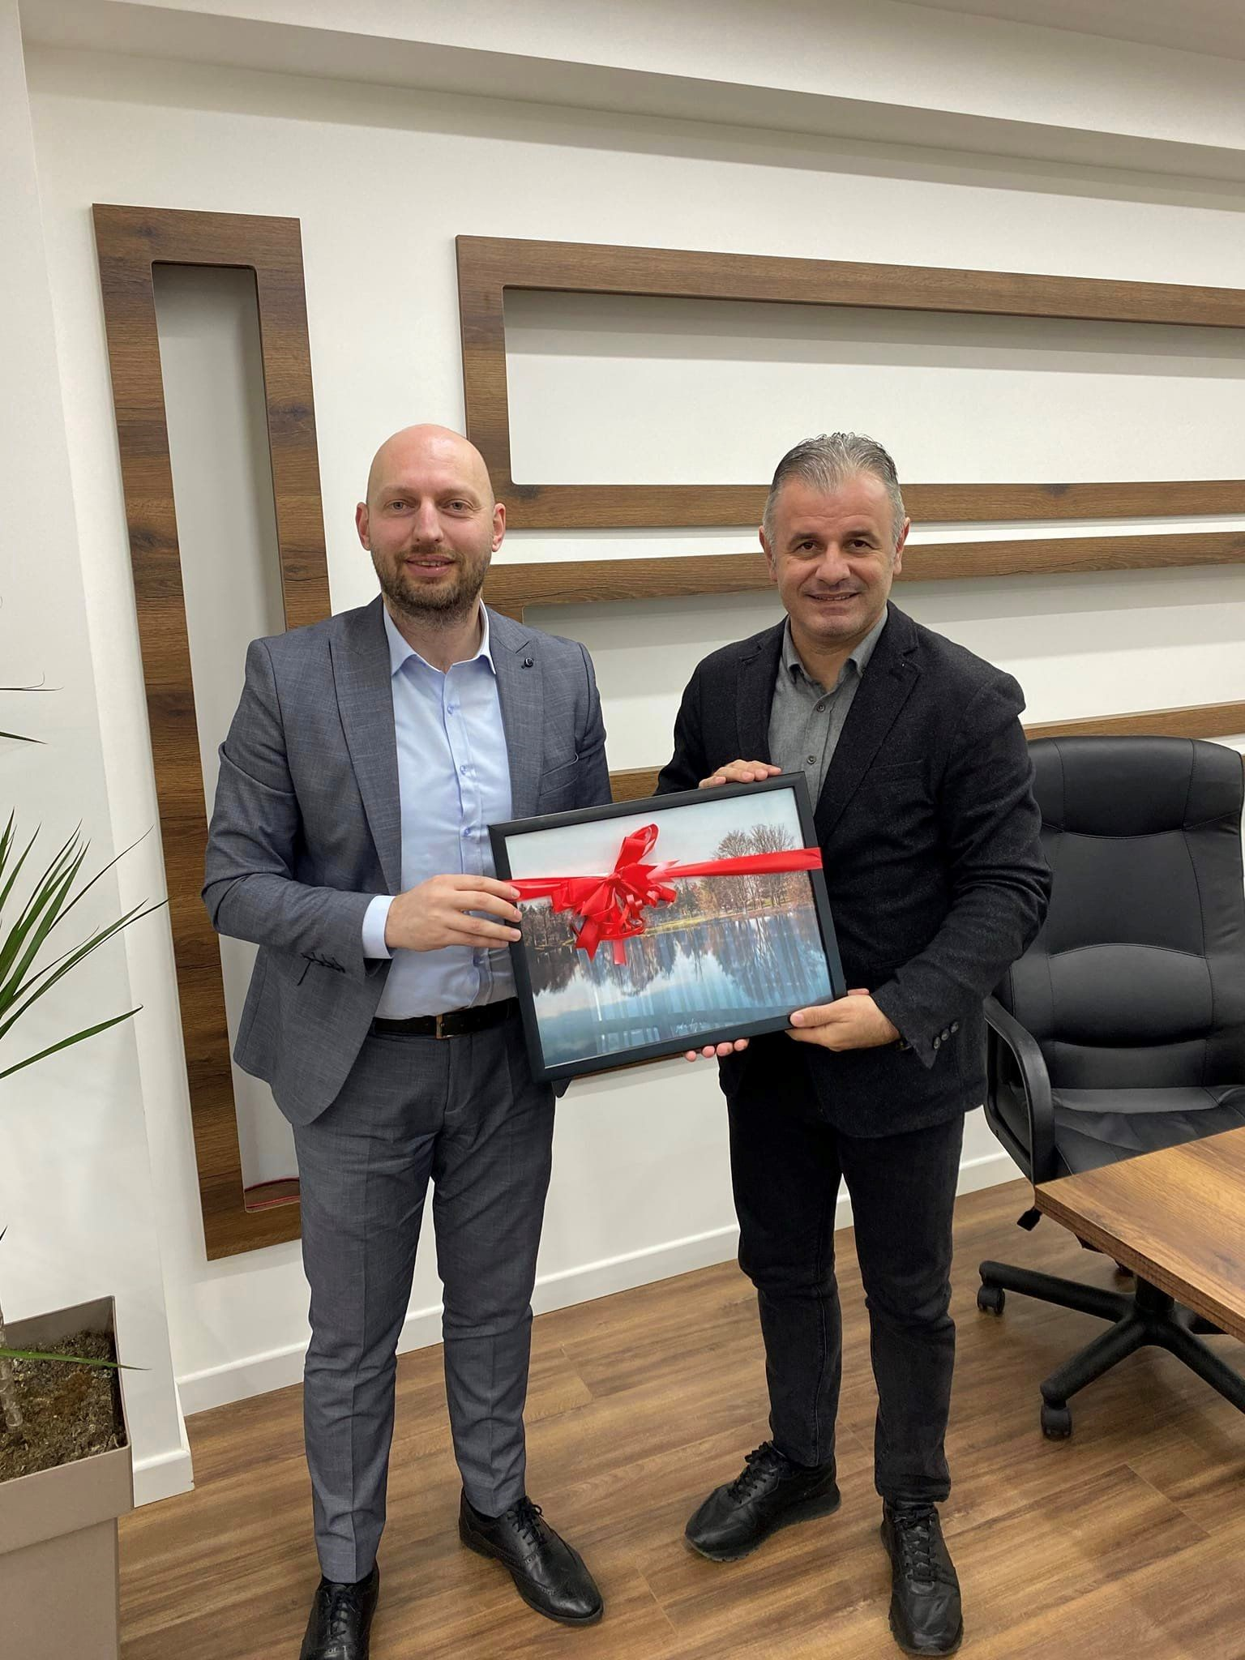
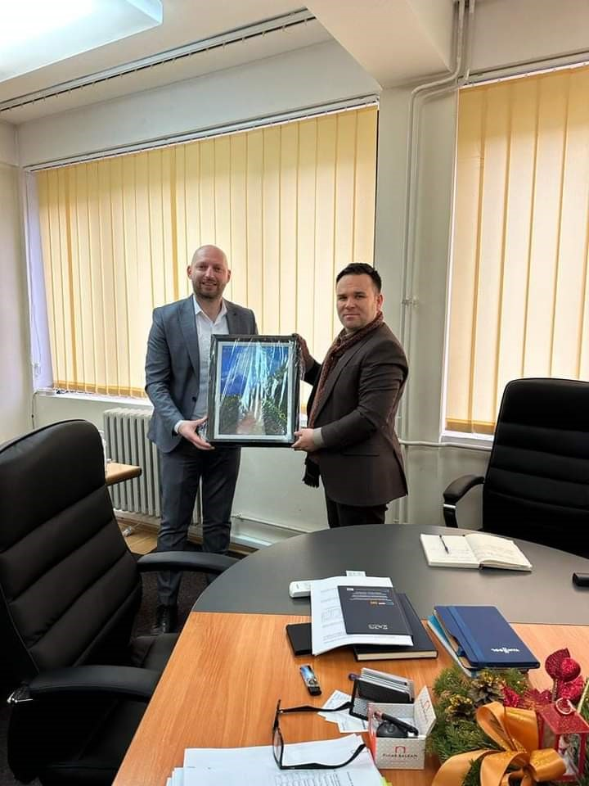
GIFT FUND 2022/23
President of the Republic of North Macedonia, Professor Dr. Stevo Pendarovski
Deputy Prime Minister of Economic Affairs of North Macedonia, Mr. Fatmir Bytyq
Mayor of Dojran Municipality Mr. Ango Angov
Mayor of the Municipality of Strumica, Mr. Kostadin
Jeton Shaqiri, Minister of Education and Science of North Macedonia
Vice-Mayor of the City of Skopje Mr. Aleksandar Trajanovski
Mayor of the Municipality of Cair, Mr. Visar Ganiu
Director of the Employment Service Agency of the Republic of North Macedonia, Mr. Bekim Murati.

Slide 4
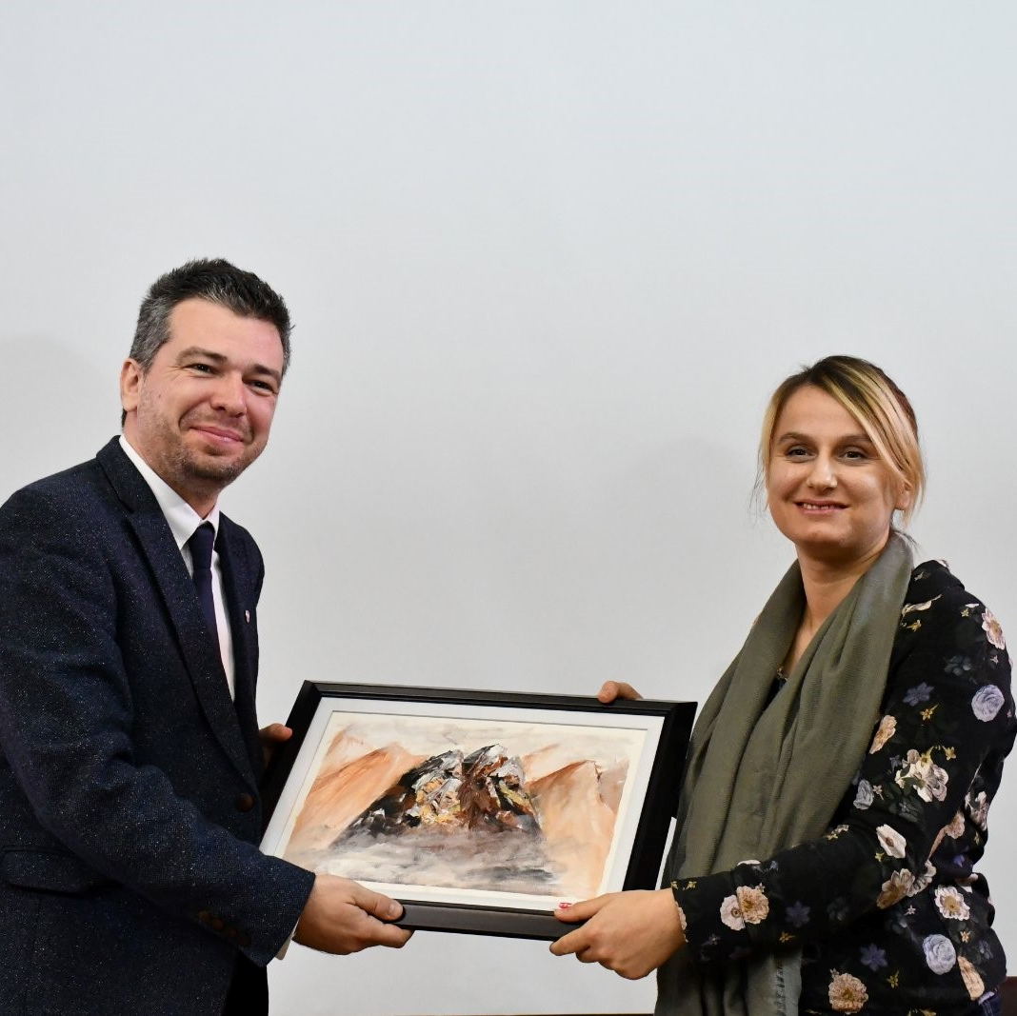
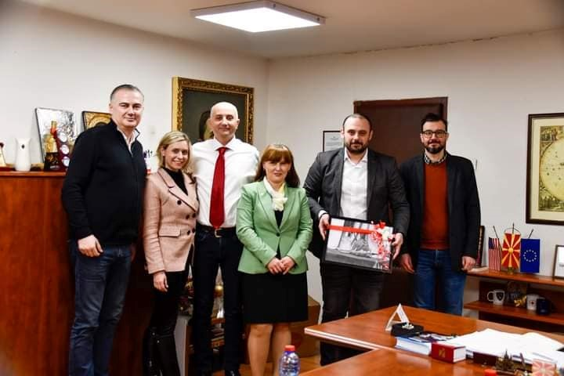
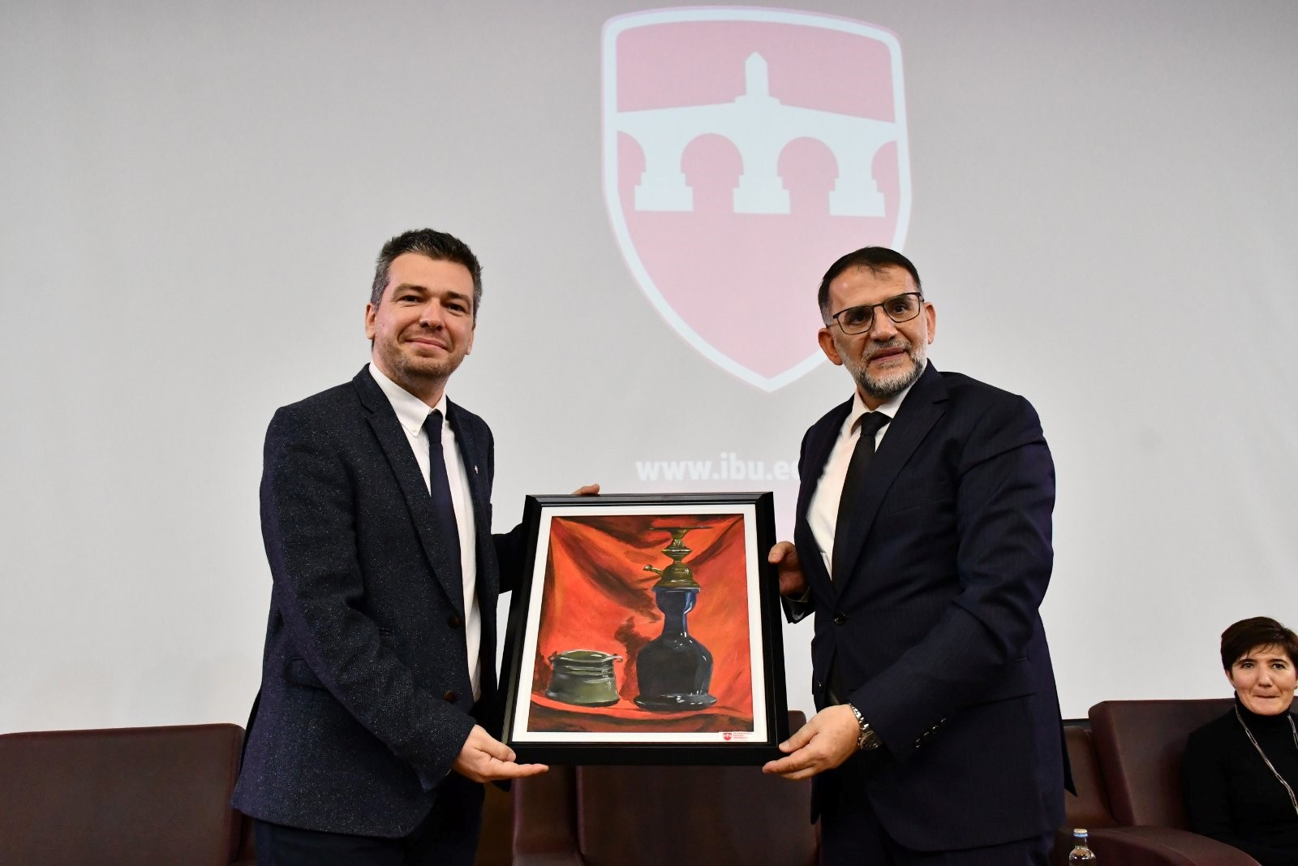
Deputy Prime Minister of Economic Affairs of North Macedonia, Mr. Fatmir Bytyq
Mayor of Dojran Municipality Mr. Ango Angov
Ms. Vera Kondikj Mitkovska, education specialist - UNICEF
Hosted by the mayor of the municipality, Mr. Orce Gjorgjievski, and his team
Mayor of the Municipality of Strumica, Mr. Kostadin
Jeton Shaqiri, Minister of Education and Science of North Macedonia
Salih Murati, Former President of the Constitutional Court
Mayor of the Municipality of Cair, Mr. Visar Ganiu

Slide 5
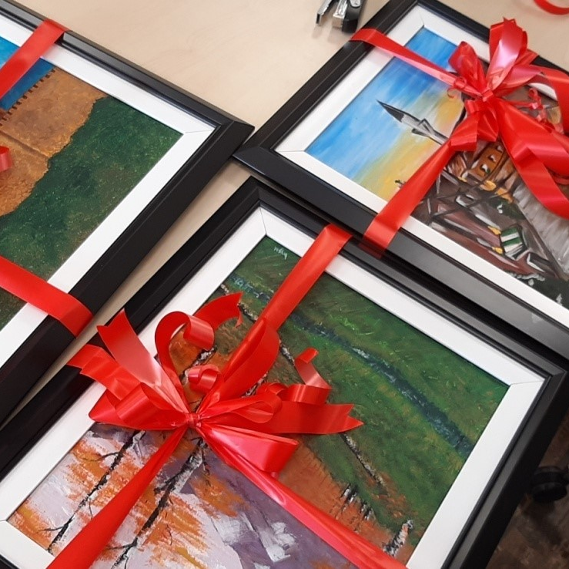
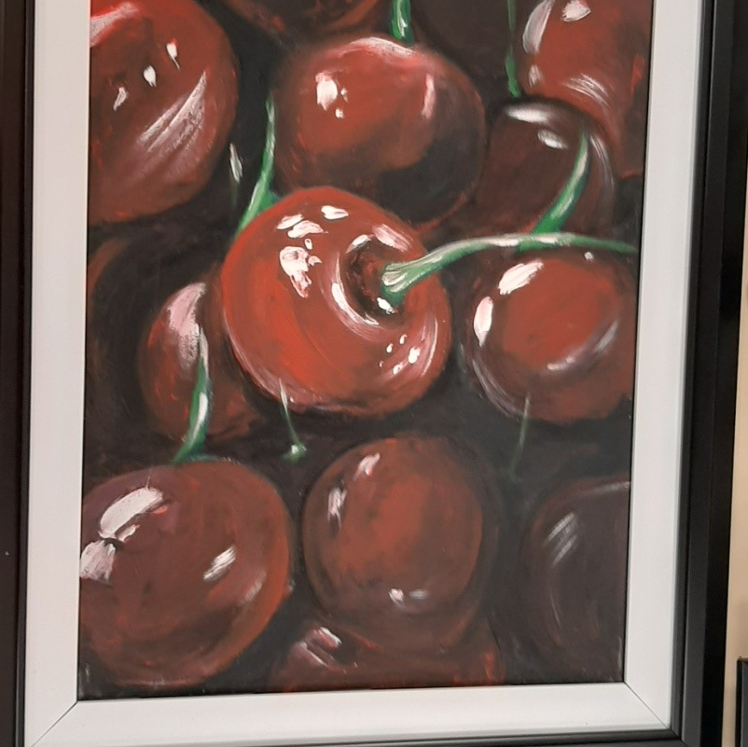
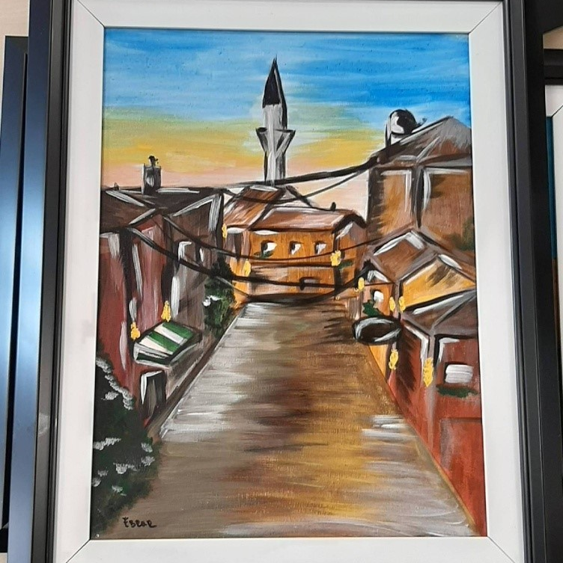
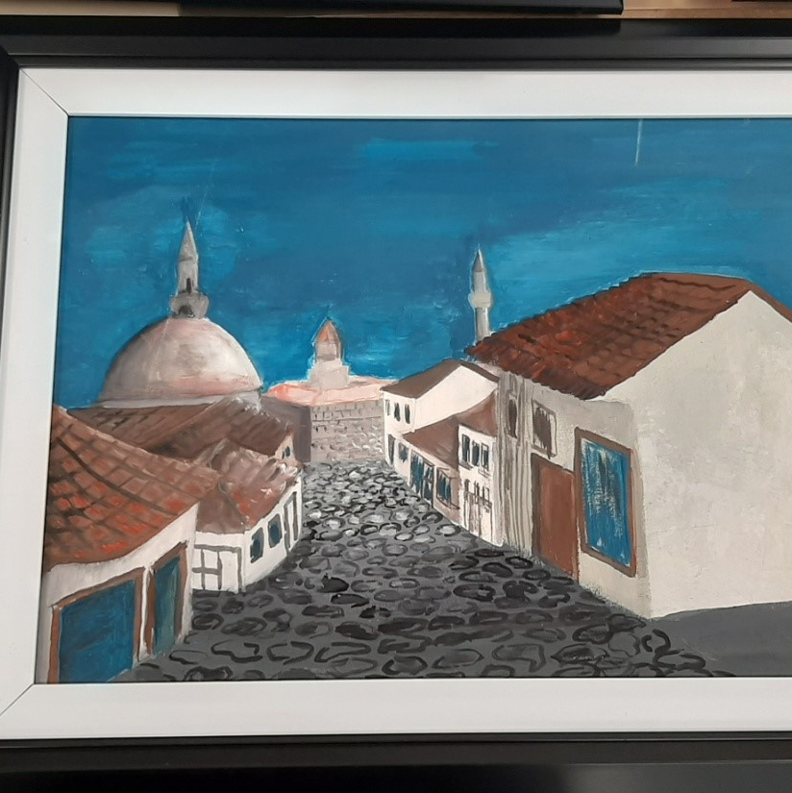
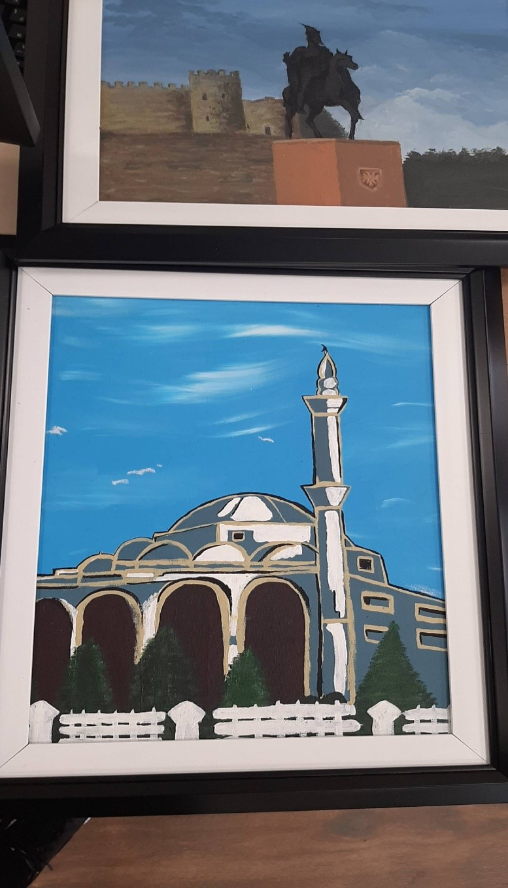
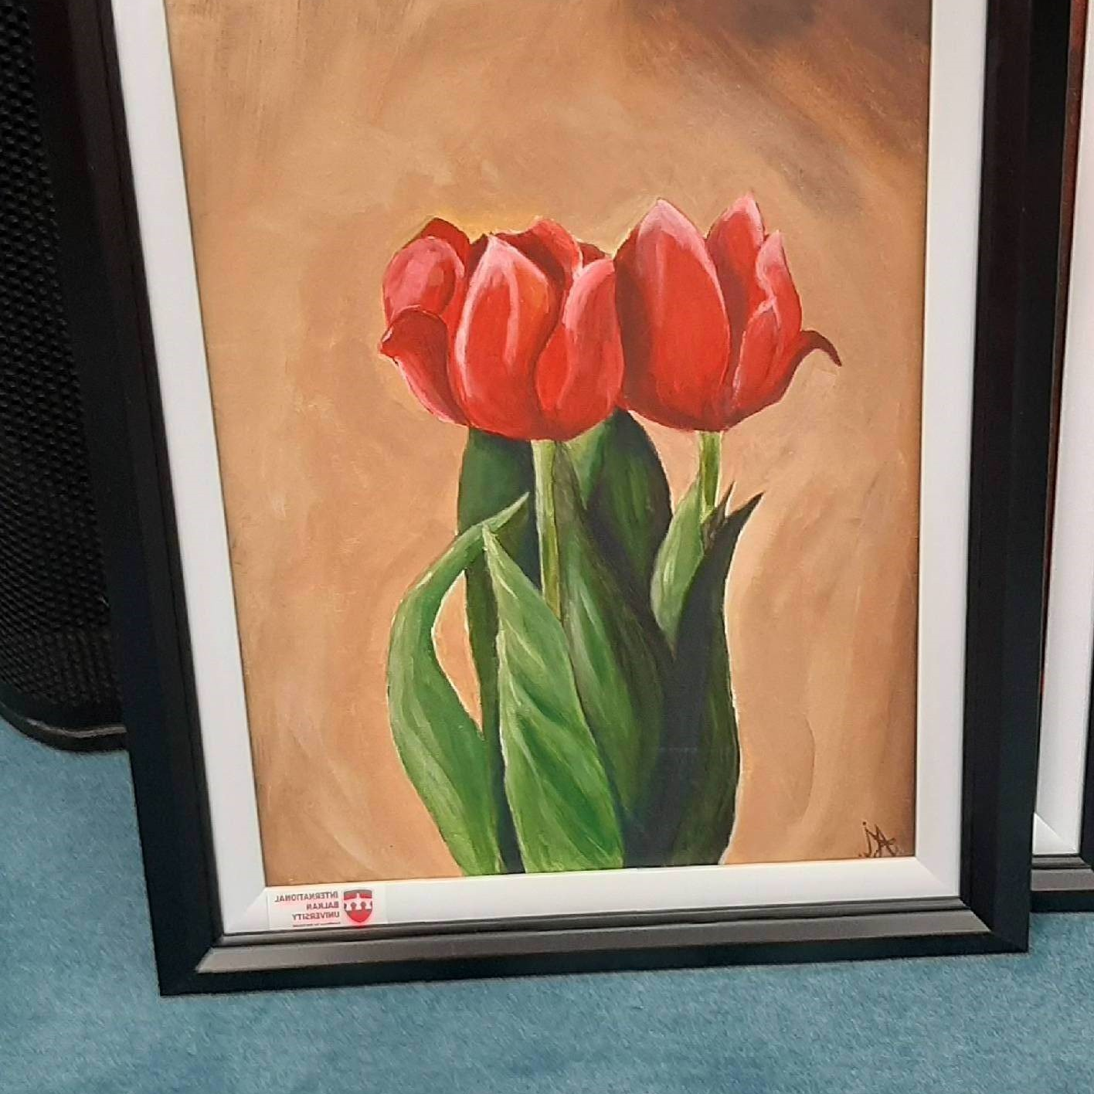
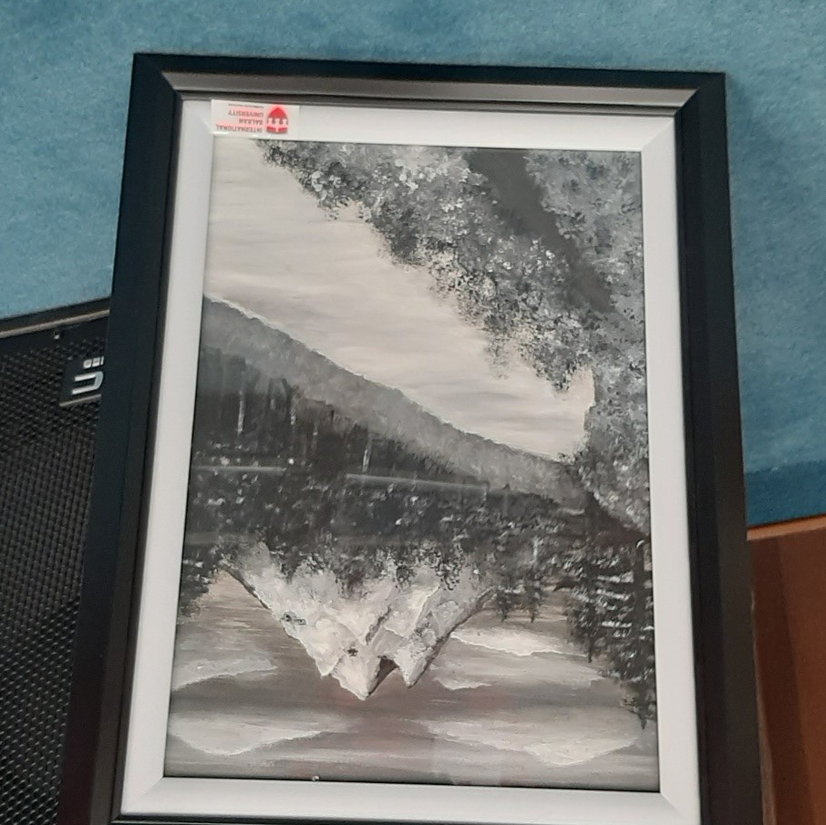
SELECTED WORKS BY STUDENTS FOR THE GIFT FOUNT

Slide 6

EXHIBITIONS
Student Exhibition in MKC
On 09.03.2023, in the gallery of the Youth Cultural Center (МКЦ), a student exhibition from the Faculty of Art and Design, International Balkan University (IBU), Skopje was opened.
In the gallery of the Youth Cultural Center, visitors will have the opportunity to see students’ works made in traditional and digital media as part of the work tasks of the Faculty of Art and Design.
The exhibition marks the cooperation between the two institutions and their contribution to the cultural and social education of young people, and it also presents the Faculty of Art and Design, International Balkan University to a wider audience.

Slide 7
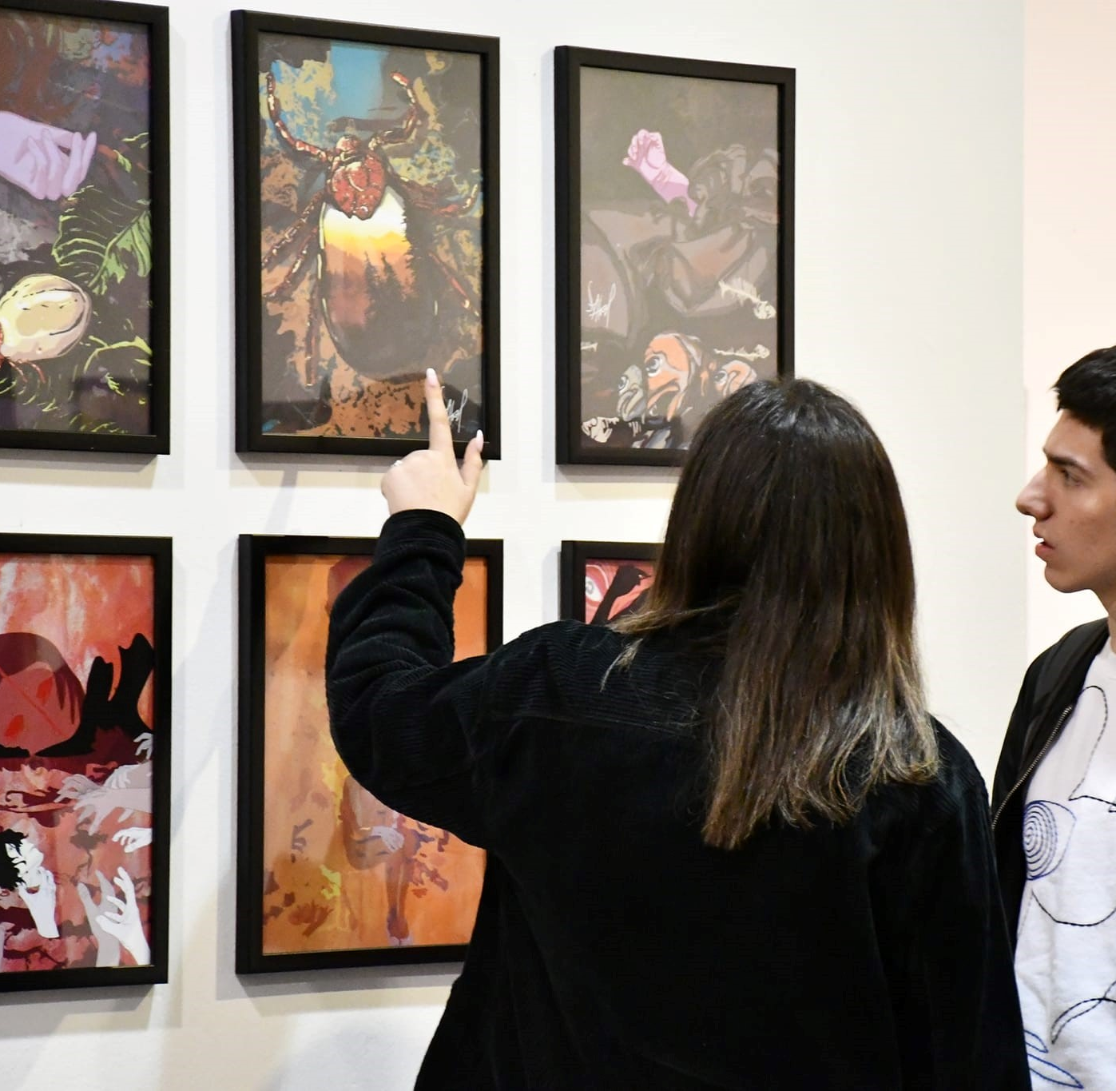
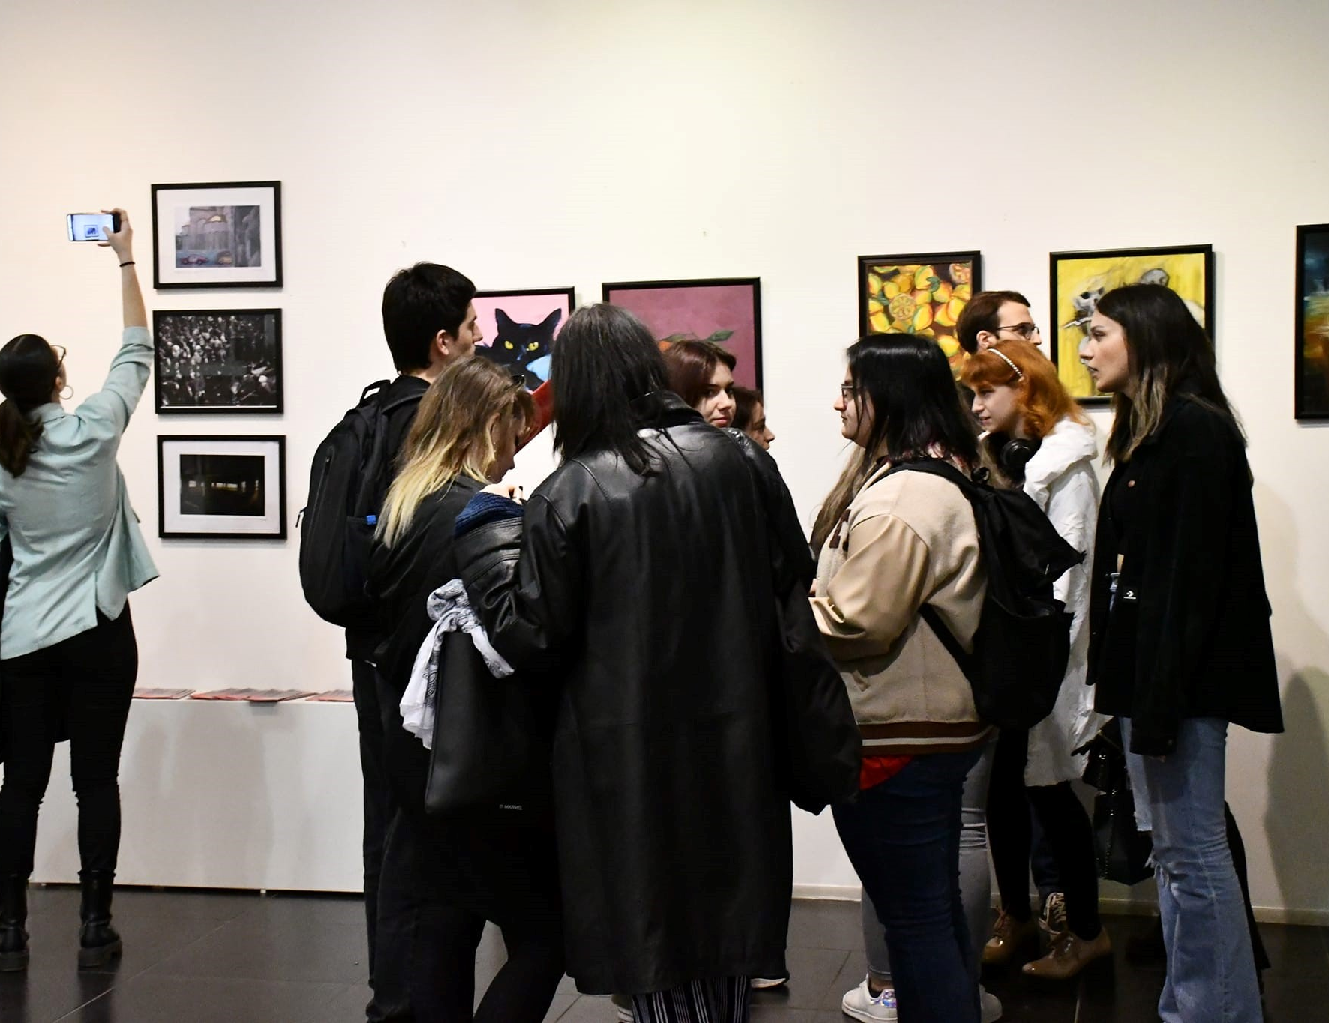
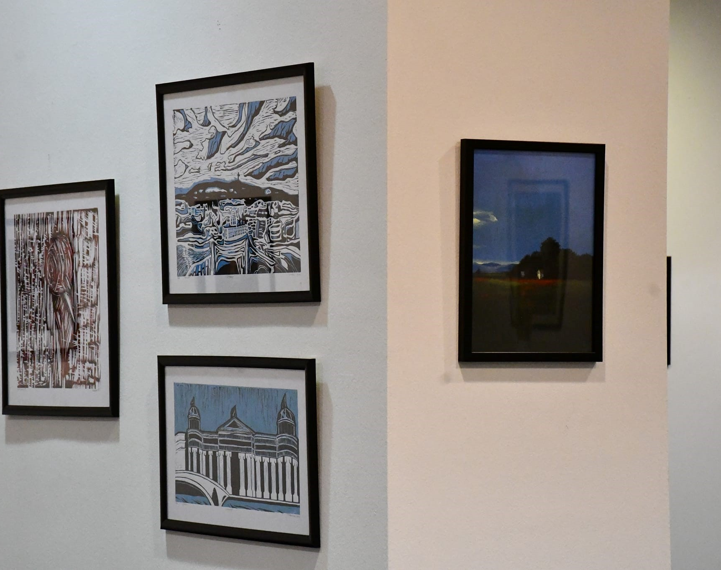
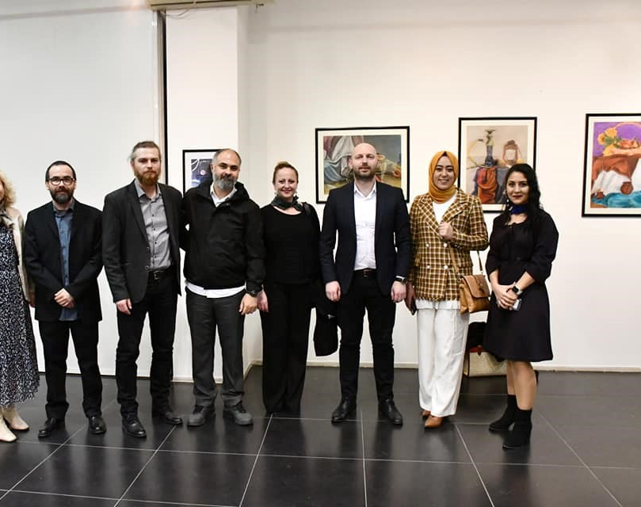
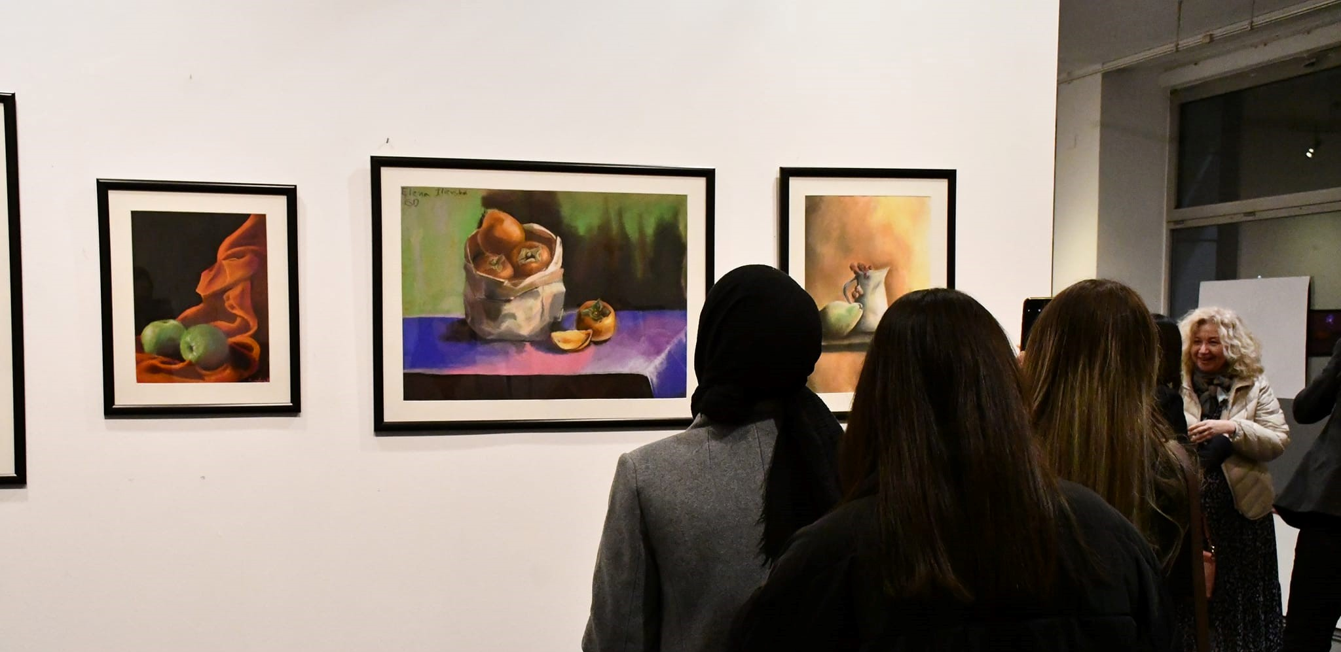
STUDENT EXHIBITION AT YOUTH CULTURAL CENTER

Slide 8

STUDENT EXHIBITION AT YOUTH CULTURAL CENTER
On 17.03.2023, in the gallery of the Youth Cultural Center, the exhibition entitled "R/Evolution" by Vladimir Gjorgjievski, Nazli Can and Aleksandra Jovanovska was opened.
The gallery will exhibit works in the field of traditional painting, digital art and works made using artificial intelligence. The exhibition is a conceptual unit composed of three different techniques for expressing the idea and the creative experience.
With this exhibition we promote our faculty, our university, our professors and students and showcase the work we create during the classes and for the classes. Events such as these are crucial for promoting and expanding our university to a wider audience and creating collaborations which will bring new projects in the future between the two institutions.

Slide 9
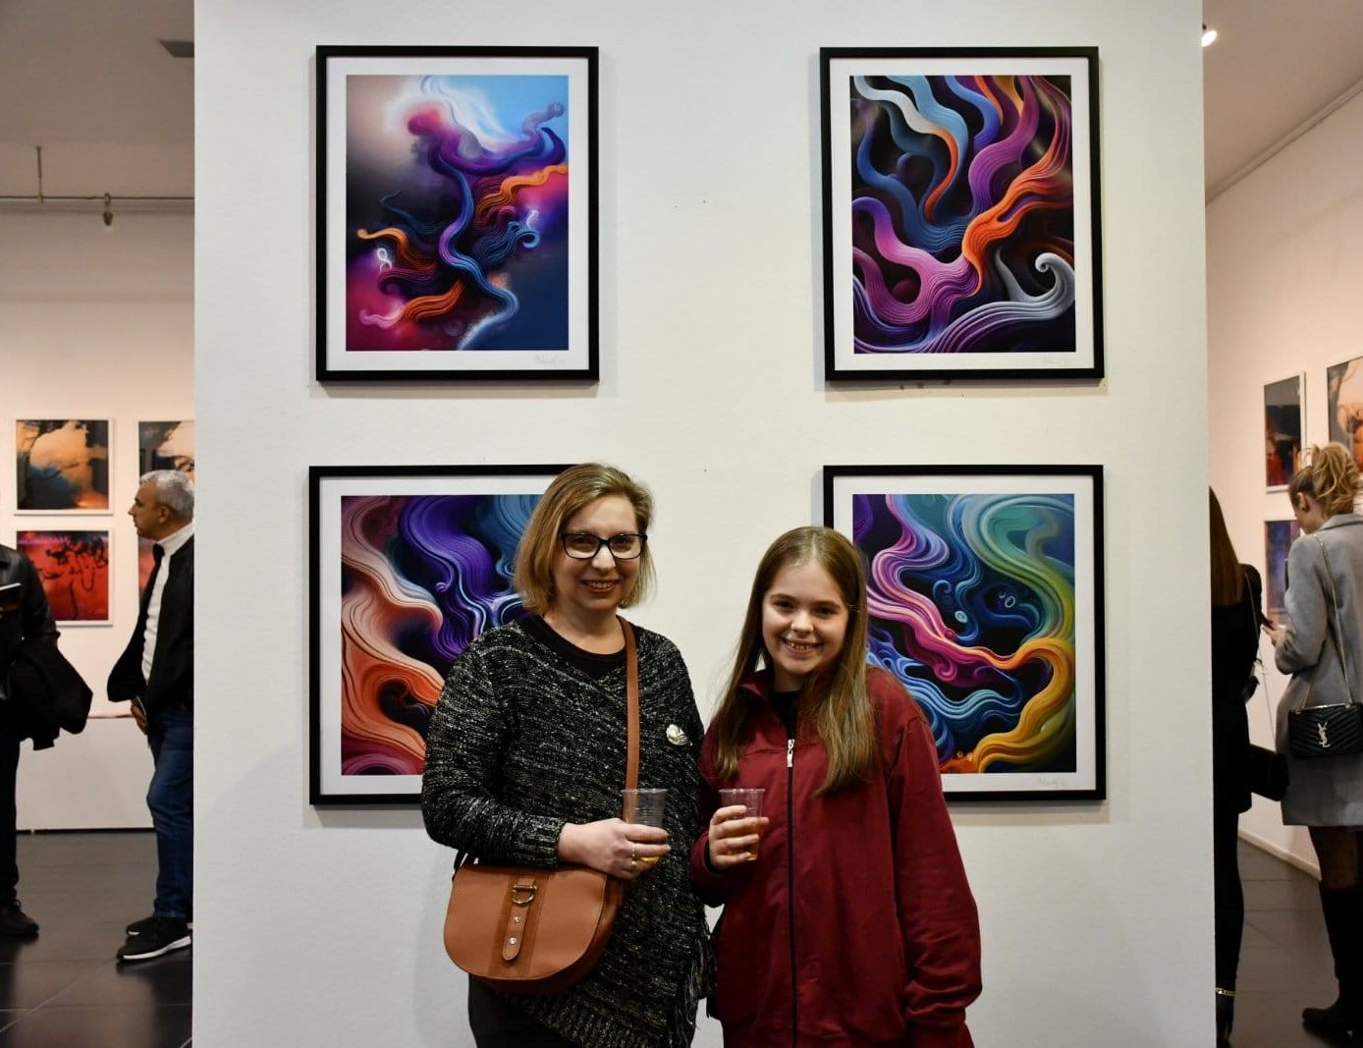
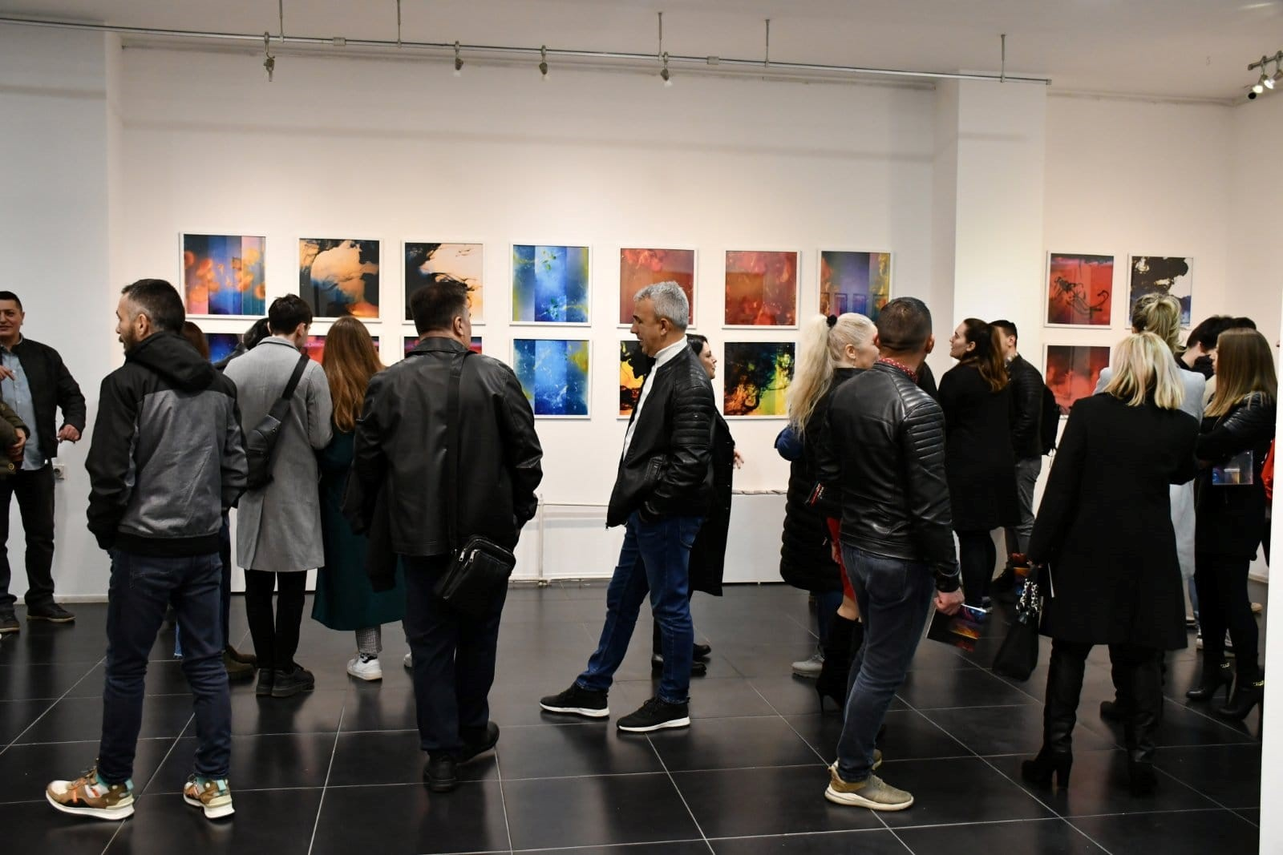
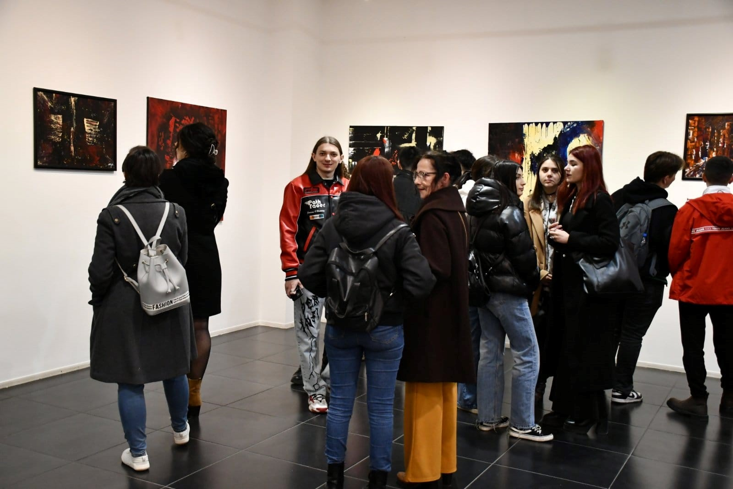
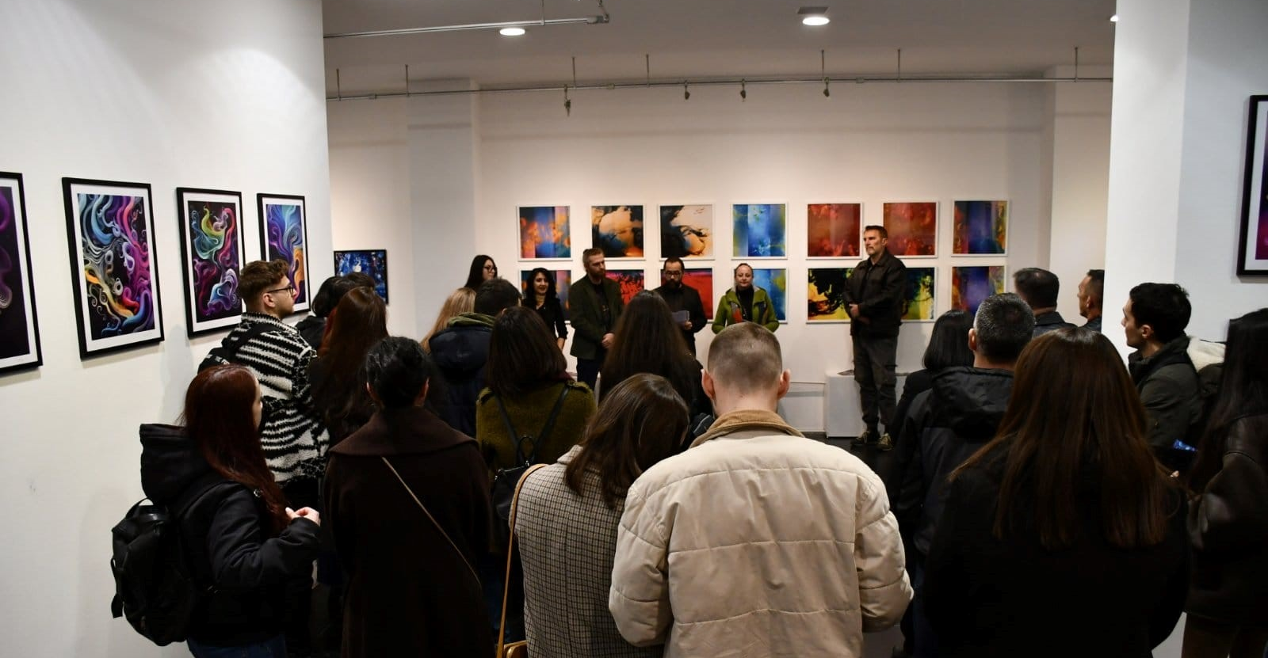
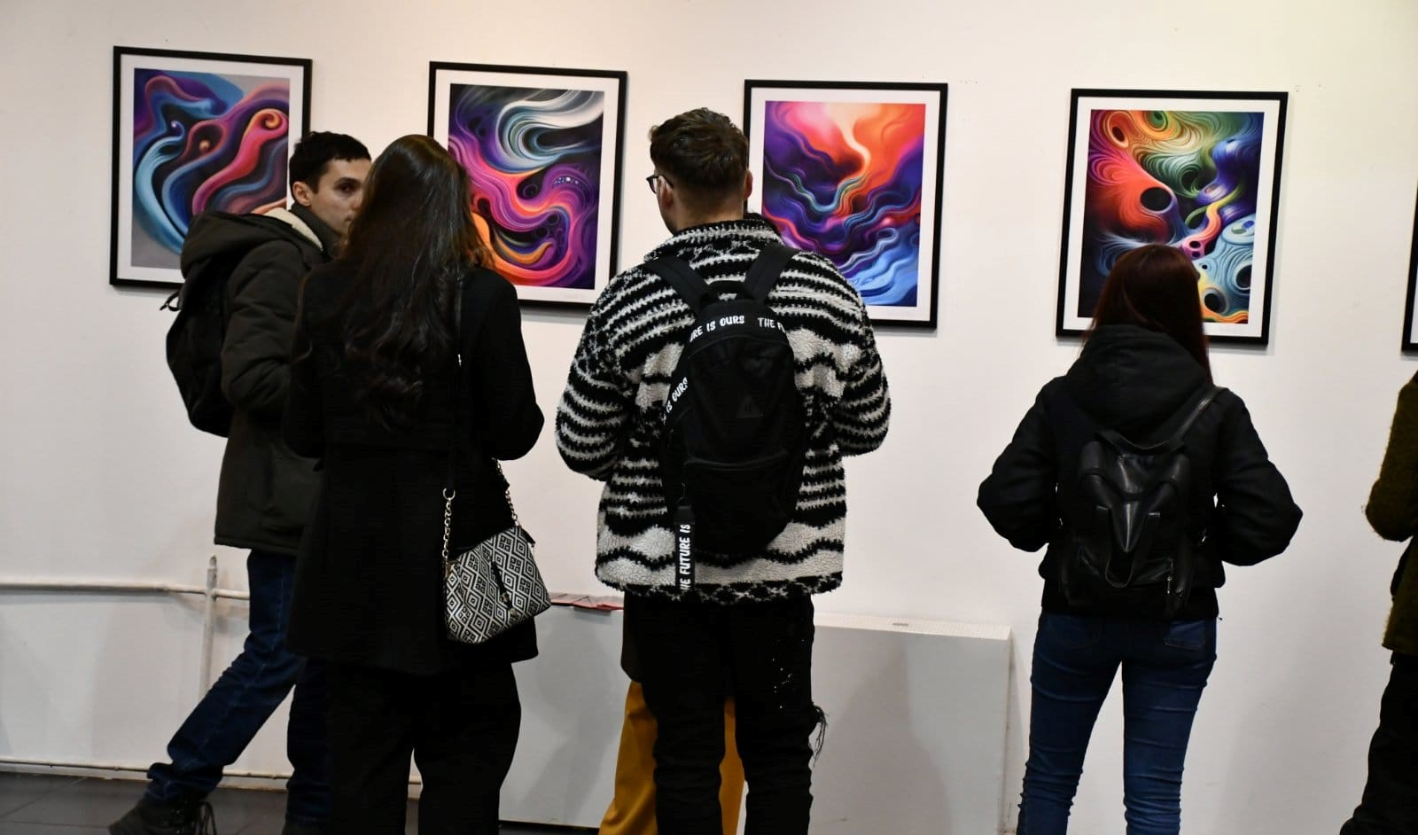
SECOND EXHIBITION AT YOUTH CULTURAL CENTER

Slide 10
Humanitarian exhibition
After the tragic earthquake in Turkey, 08.02.2023, the International Balkan University and the Faculty of Art and Design organized a humanitarian sales exhibition through which artists donated their work of art and, through the purchase of a work of art by the visitors, a donation was made to those who needed it most at the moment.
This exhibition is inspiring action and building support for humanitarian causes. It is an opportunity for individuals and the public to come together, share their experiences, and work together to create a better world for all. All of the collected funds were donated for the families hit by the earthquake.

Slide 11
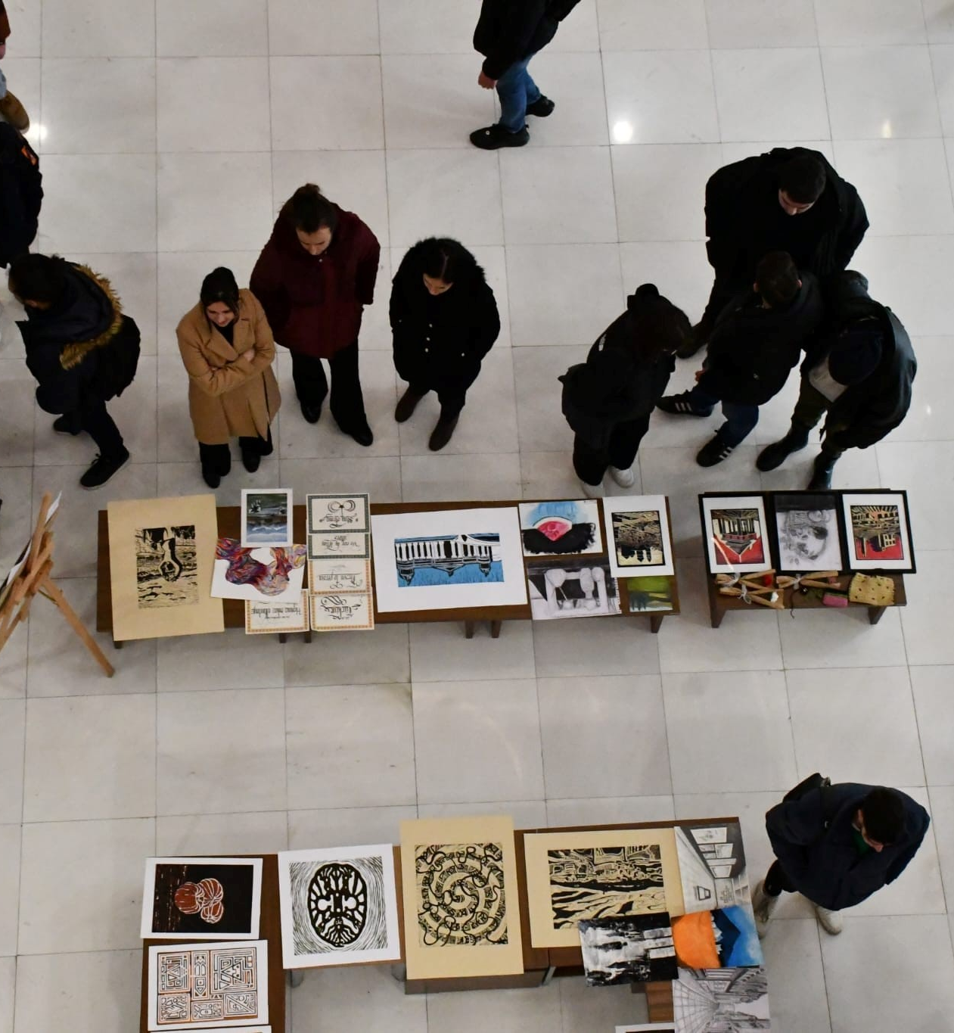
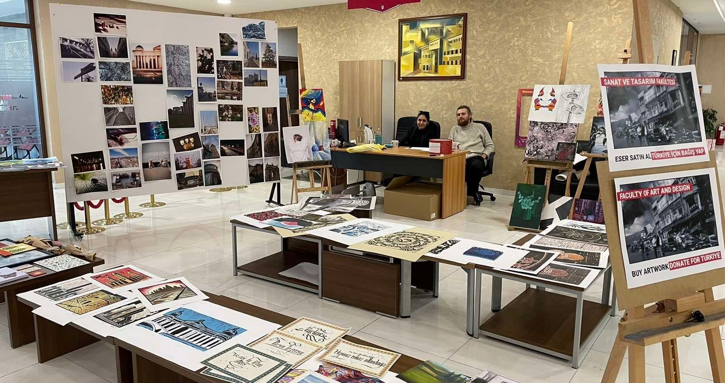
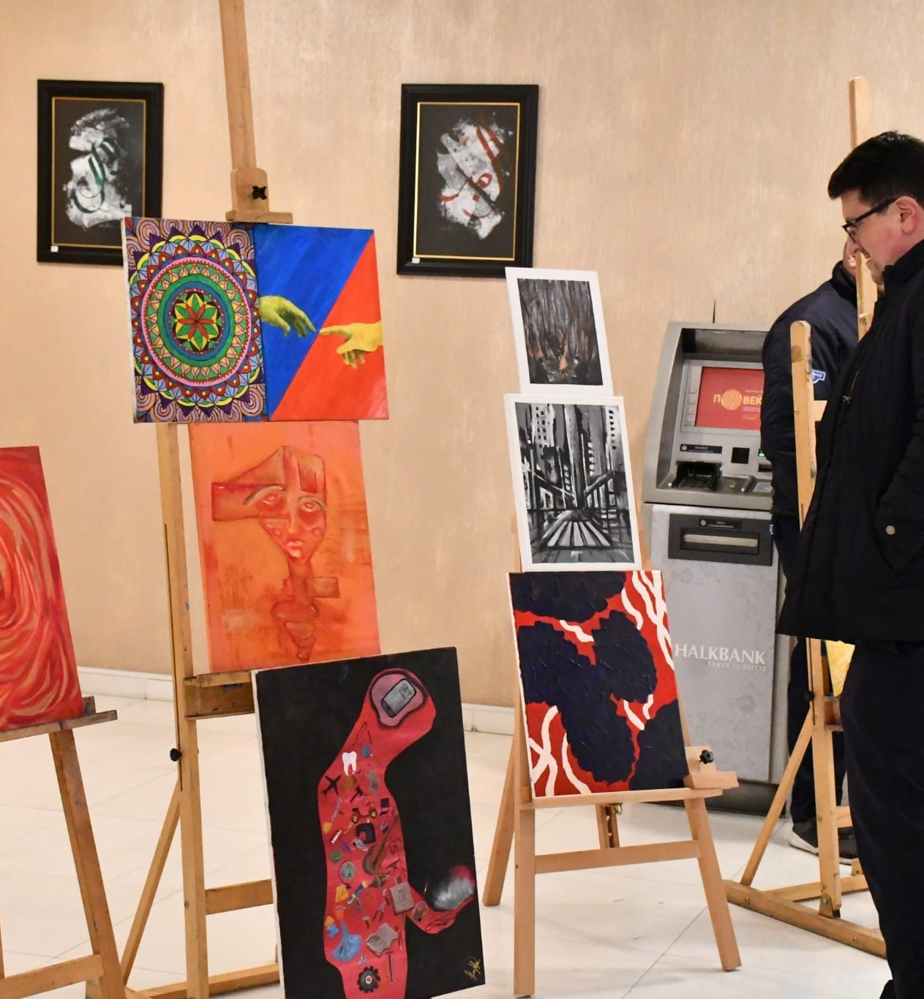
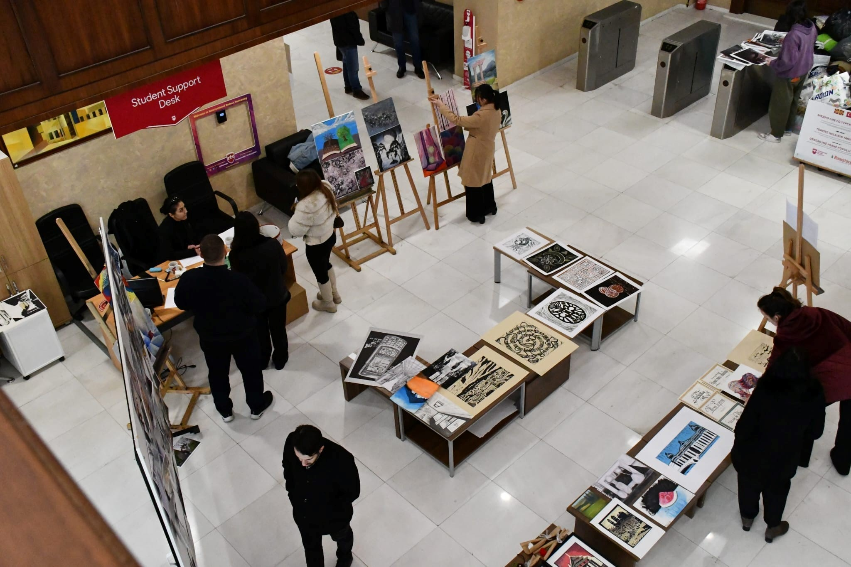
HUMANITATIAN EXHIBITION

Slide 12
ANNUAL STUDENT EXHIBITION
Wednesday, June 8, 2023,
The Faculty of Art and Design successfully opened its 13th exhibition on the premises of the International Balkan University.
We express our gratitude for the trust of our students and the support of all colleagues and art lovers. These exhibitions wouldn't be possible without all of you.
The exhibition will be open to the public until September 5, 2023.

Slide 13
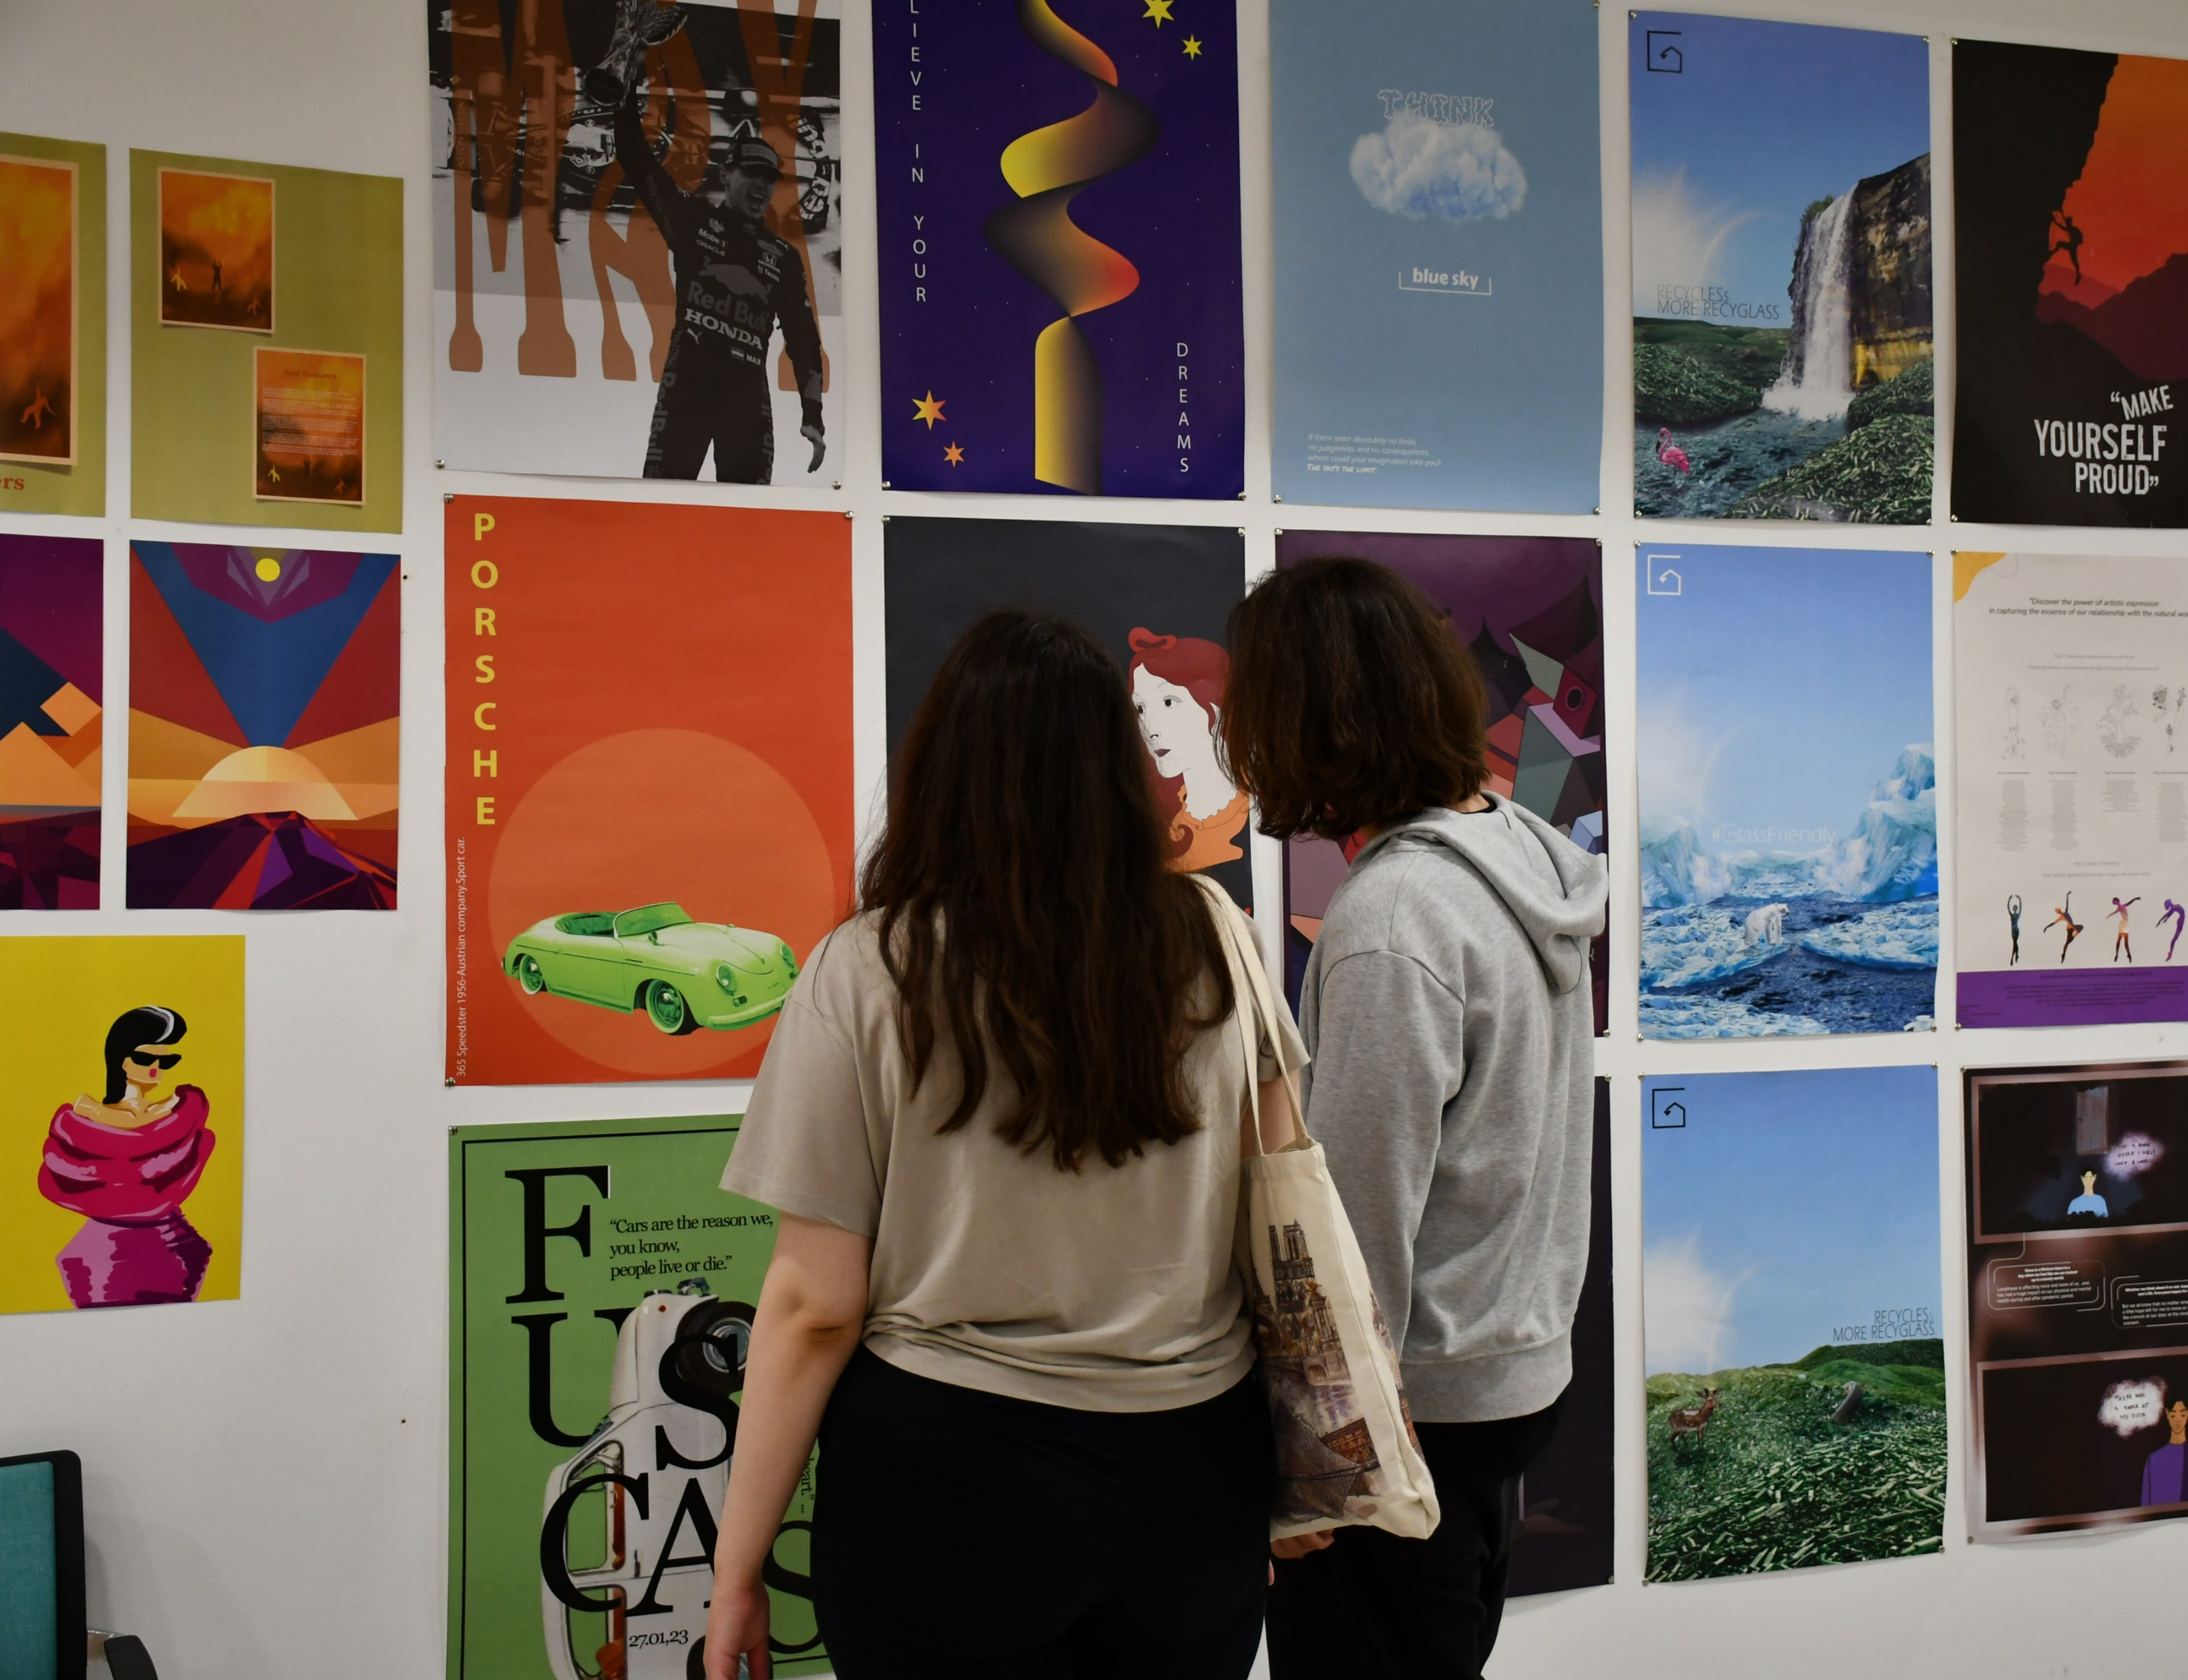
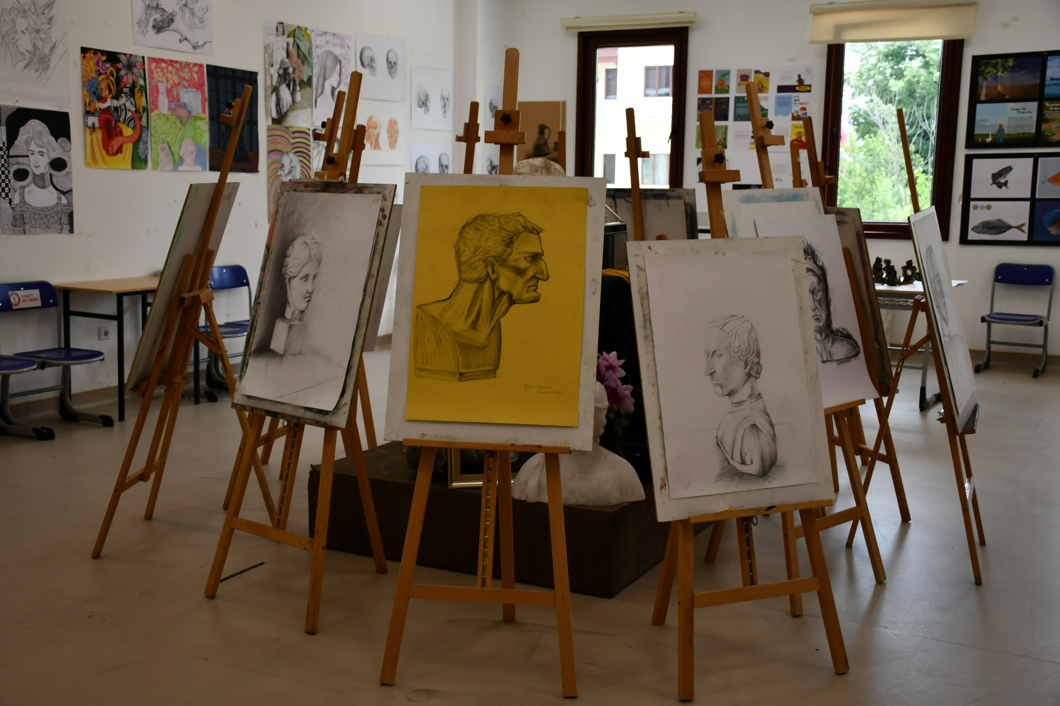
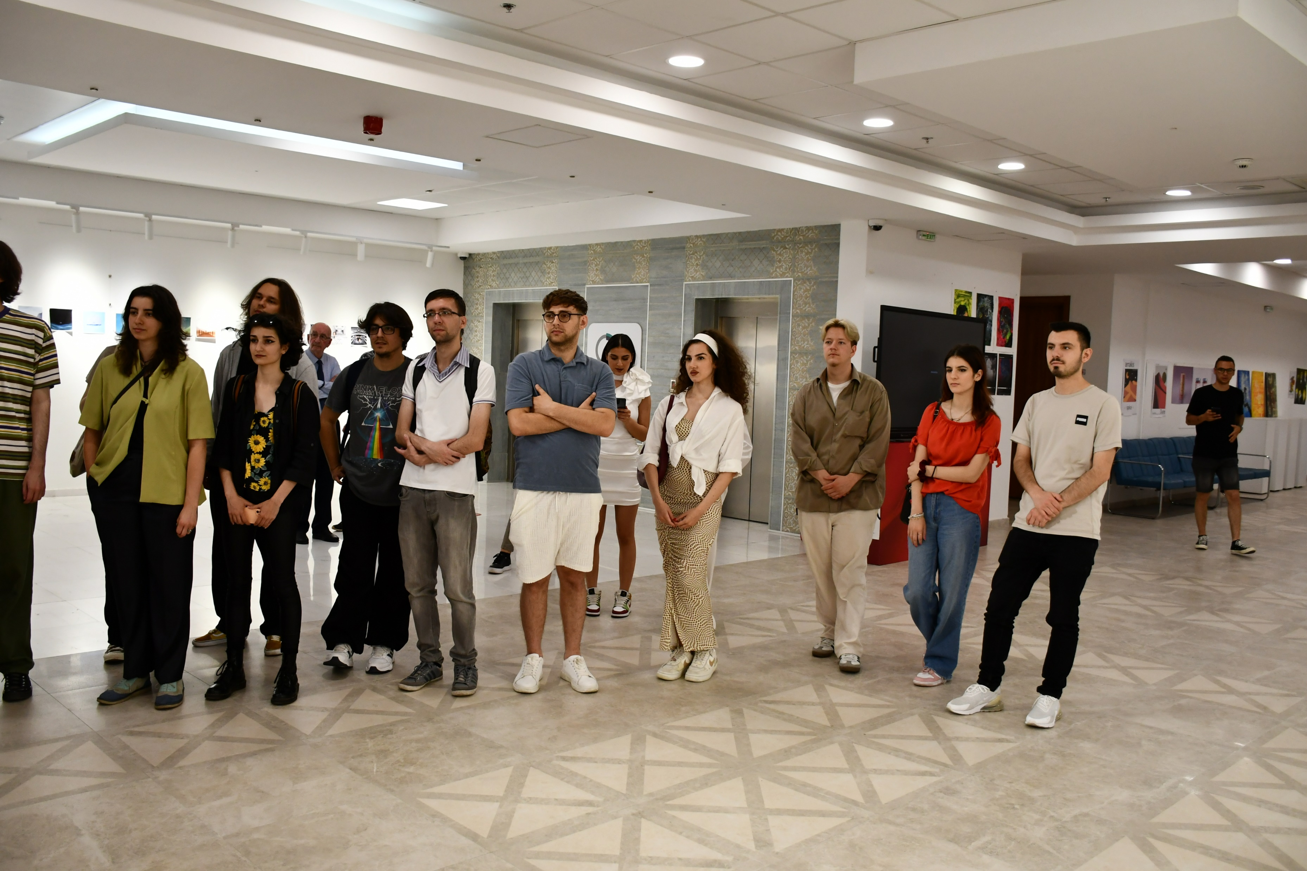
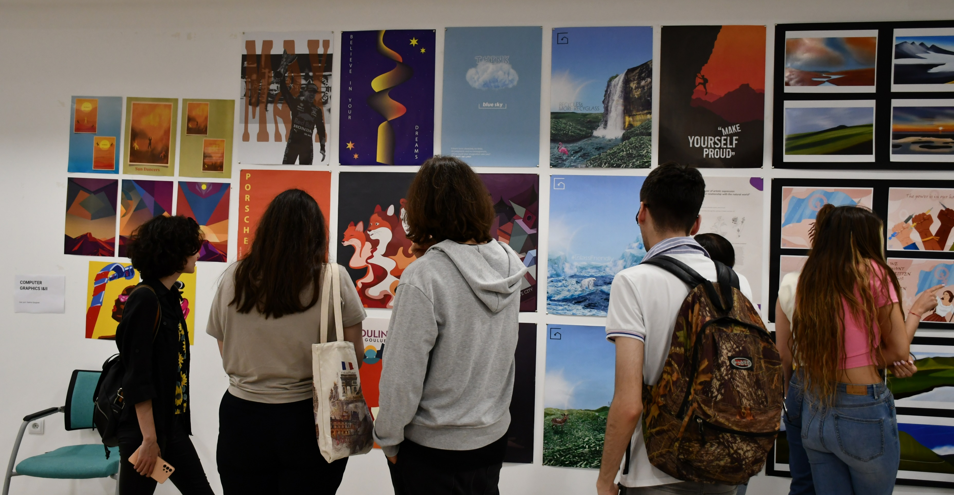
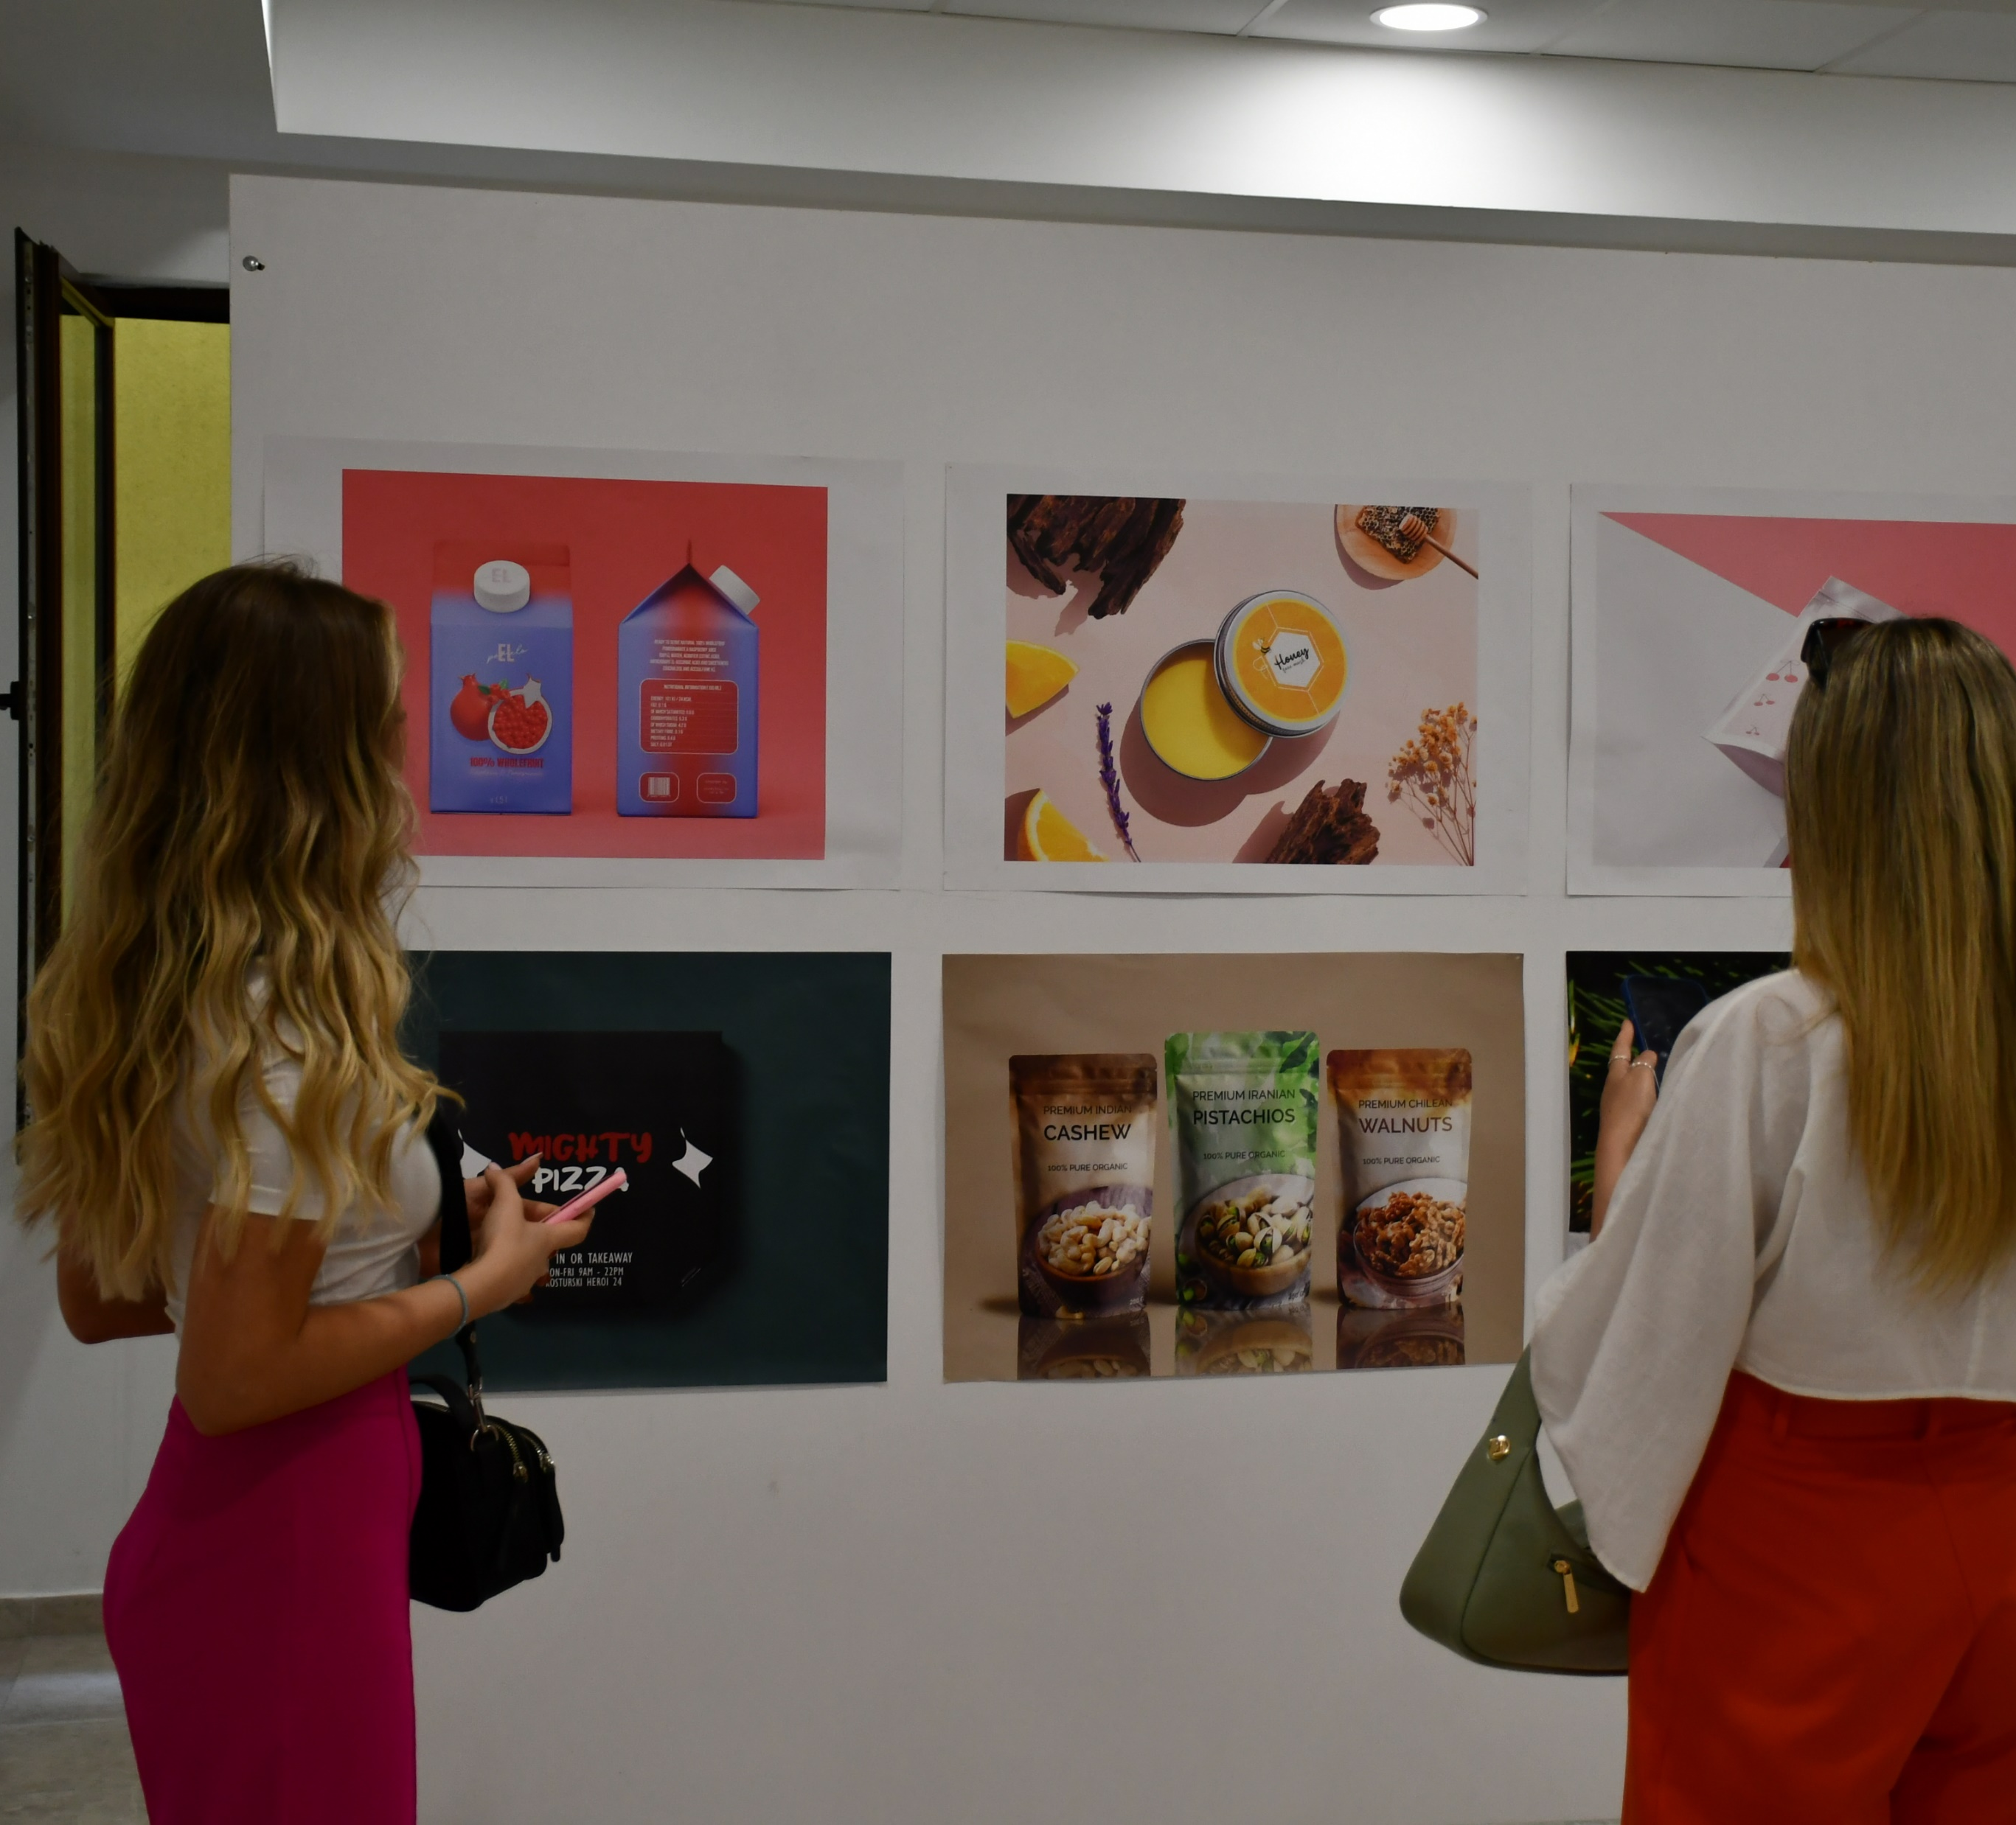
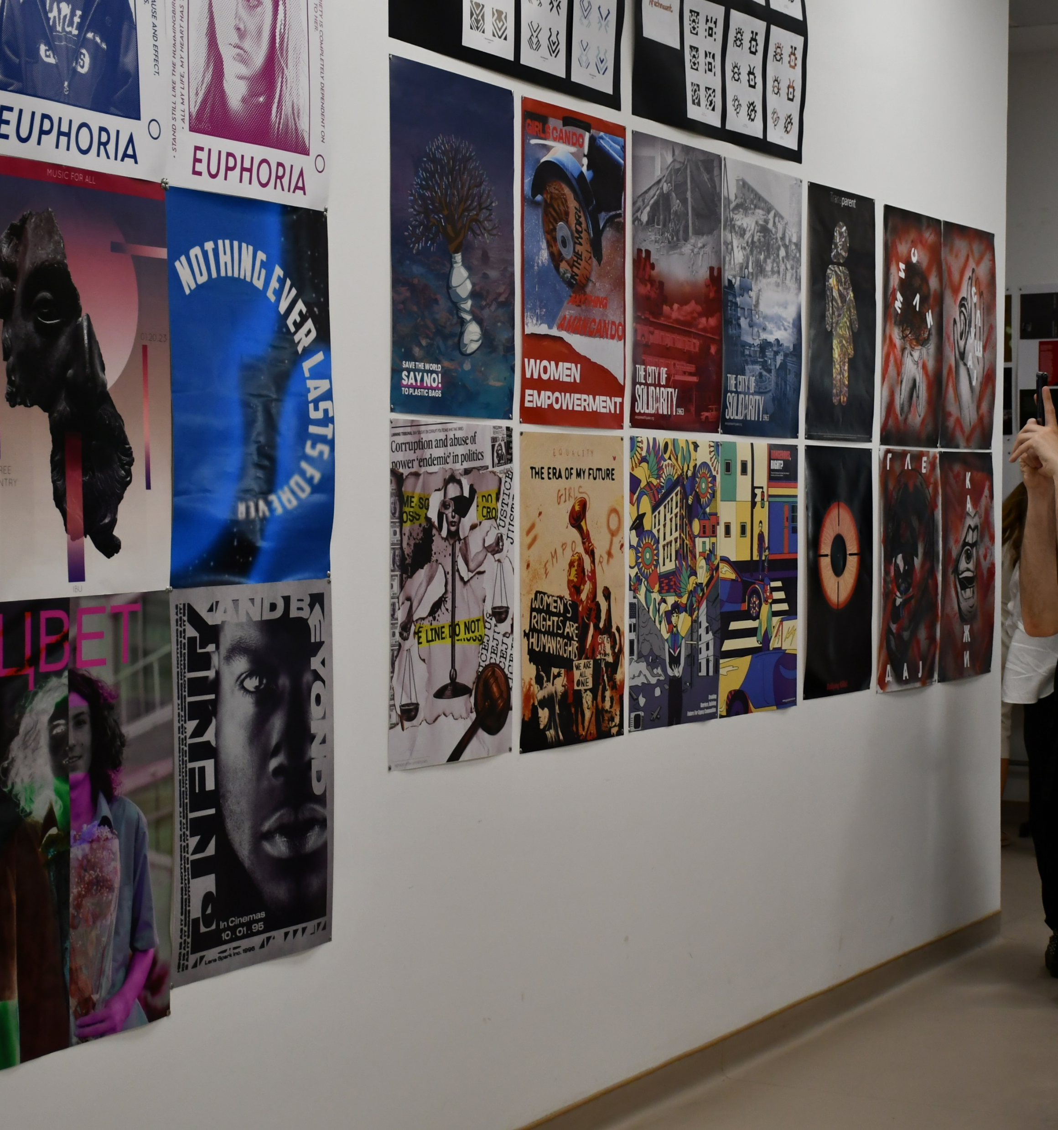
ANNUAL STUDENT EXHIBITION

Slide 14
PROFESSORS AND STUDENTS' EXHIBITION MKC
09.06.2023 Tuesday
Students and academicians from the Faculty of Art and design
took place on the exhibition named Professors and students Exhibition
The purpose of the exhibition is to emphasize the wide spectrum
of curricula available to private and state universities in Macedonia,
to emphasize the difference between them and to actualize
the teaching potential and quality of their students with works
from the field they studied.

Slide 15
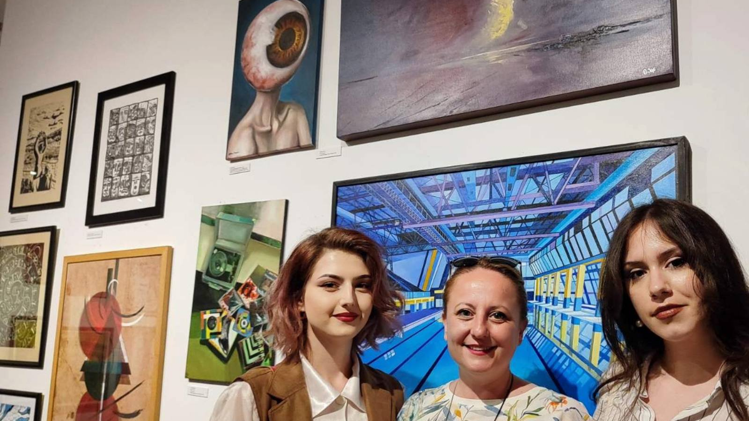
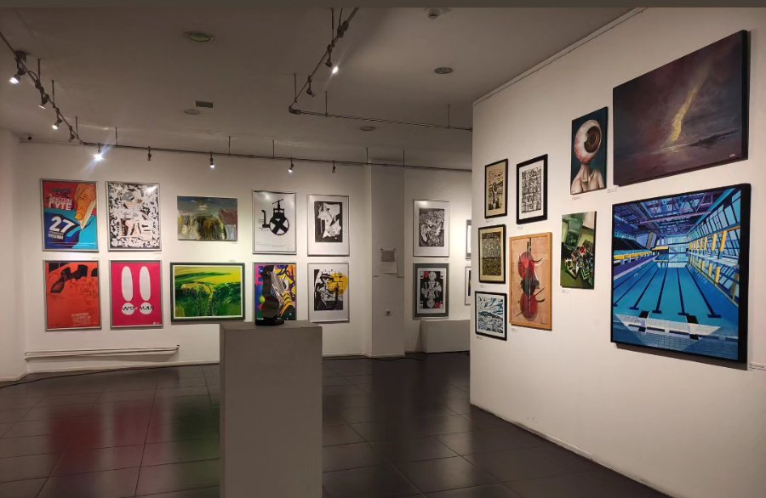
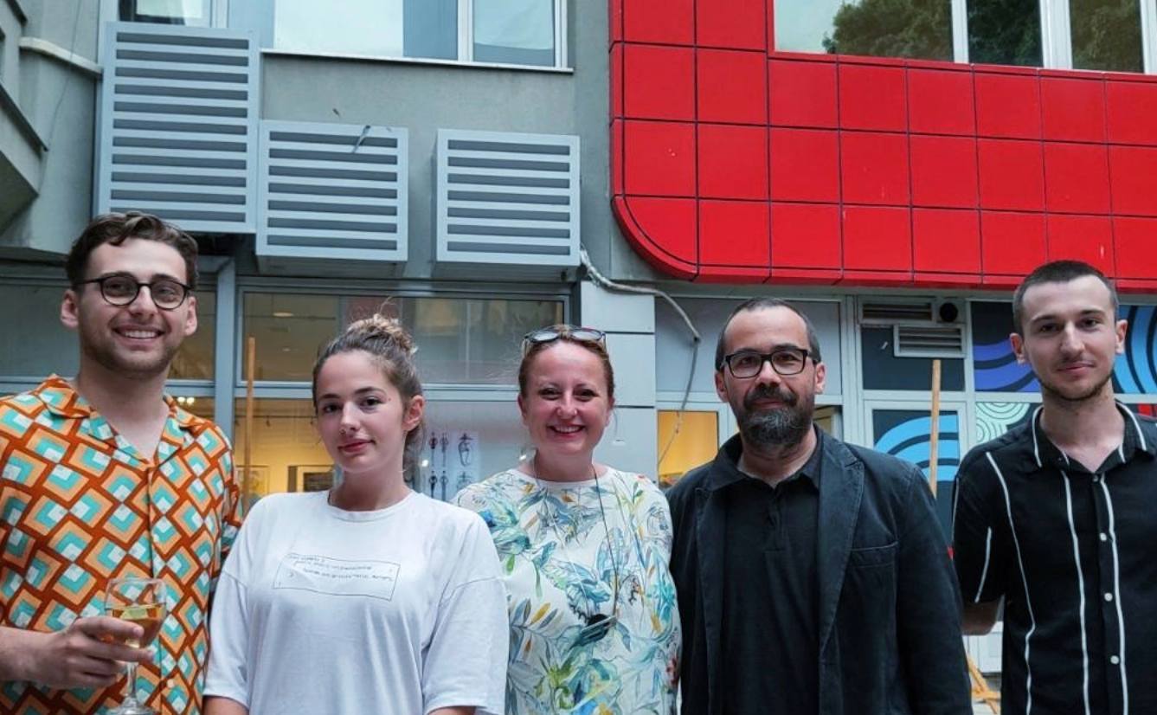

PROFESSORS AND STUDENT'S EXHIBITION AT YOUTH CULTURAL CENTER

Slide 16
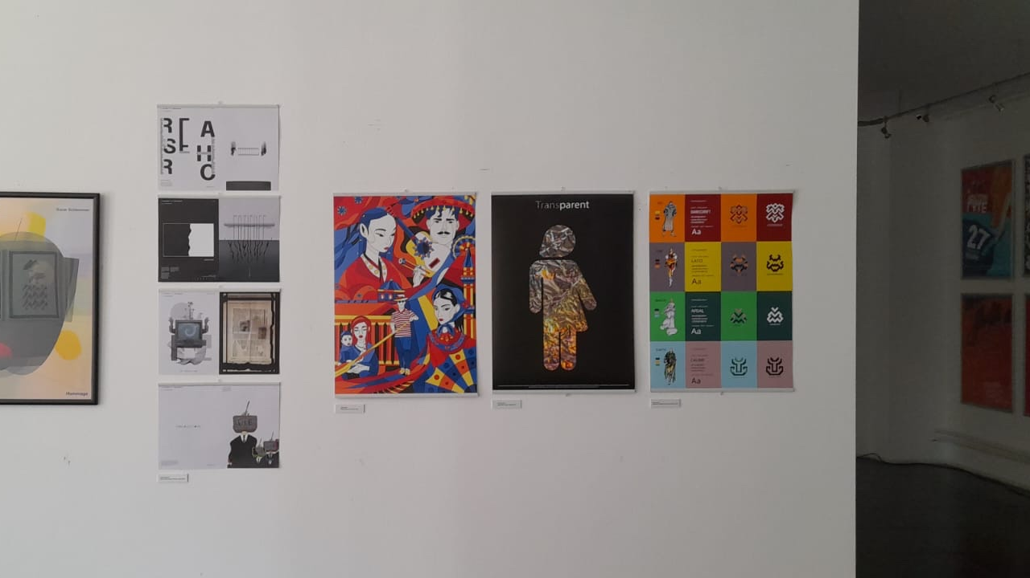

Slide 17

26.06.2023 it was announced officially that our university has become a member of the @World Design Organization (WDO), an international non-governmental organization that promotes the profession of design and its ability to generate better products, systems, services, and experiences; better business and industry; and ultimately a better environment and society. WDO includes over 170 member organizations from more than 40 nations, engaging them in collaborative efforts and providing them with the opportunity to be heard internationally.
IBU is the first member of WDO in this region.
This membership will provide connection and collaboration with fellow WDO members both in our region and internationally, obtain visibility opportunities for our organization, access to exclusive events and many more opportunities.

Slide 18

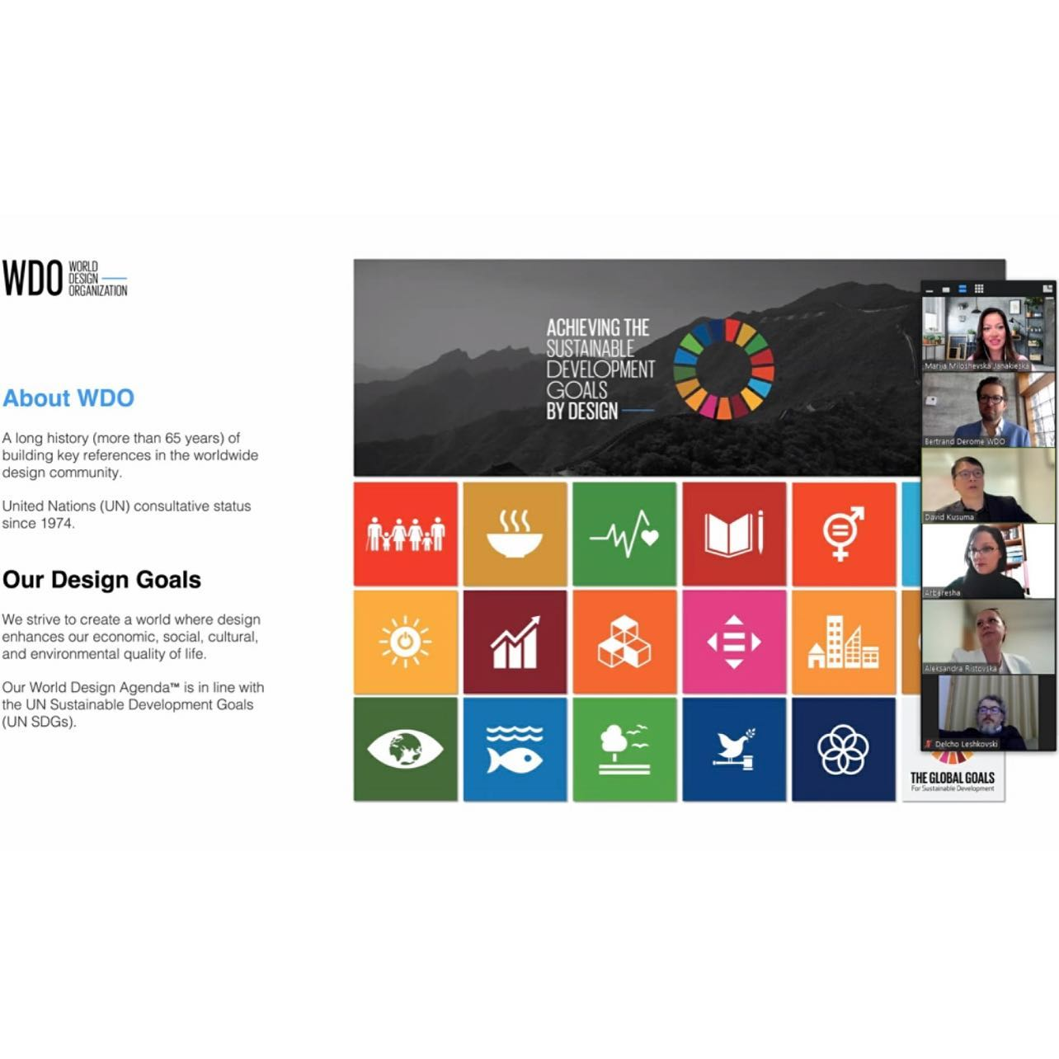

Slide 19
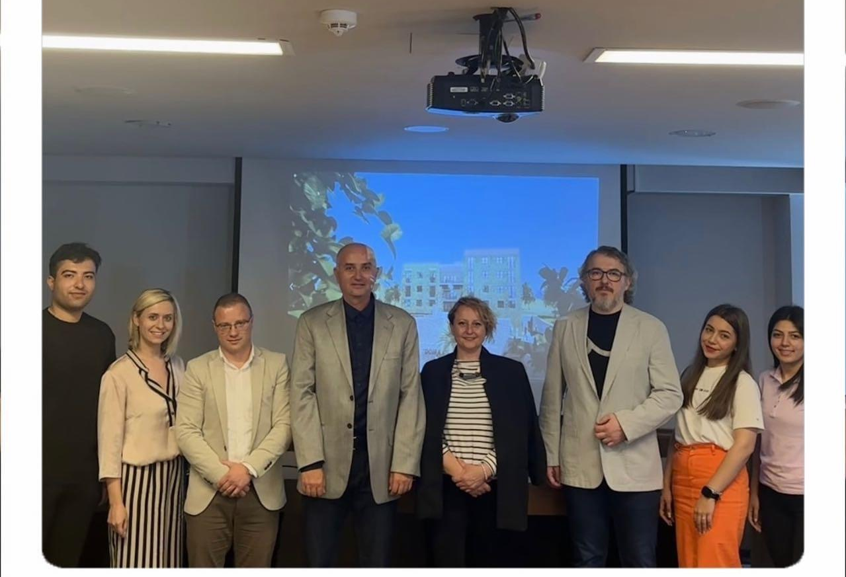
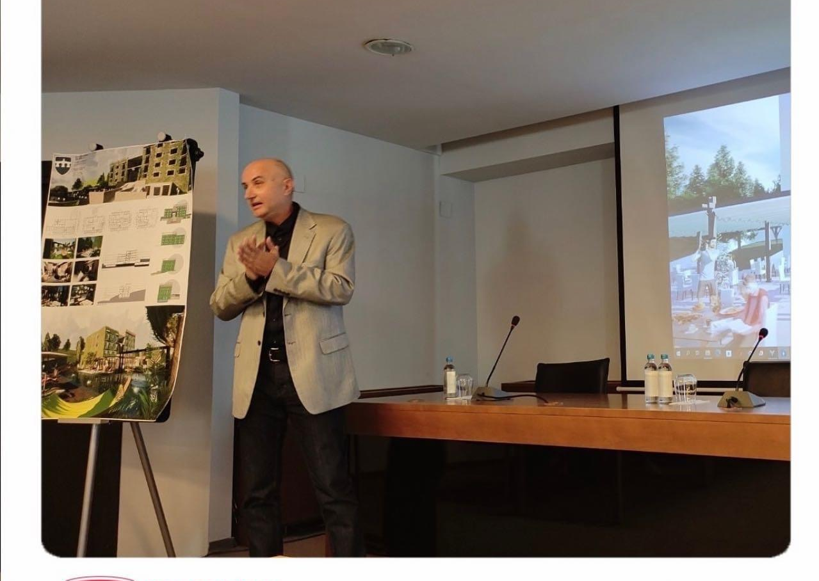
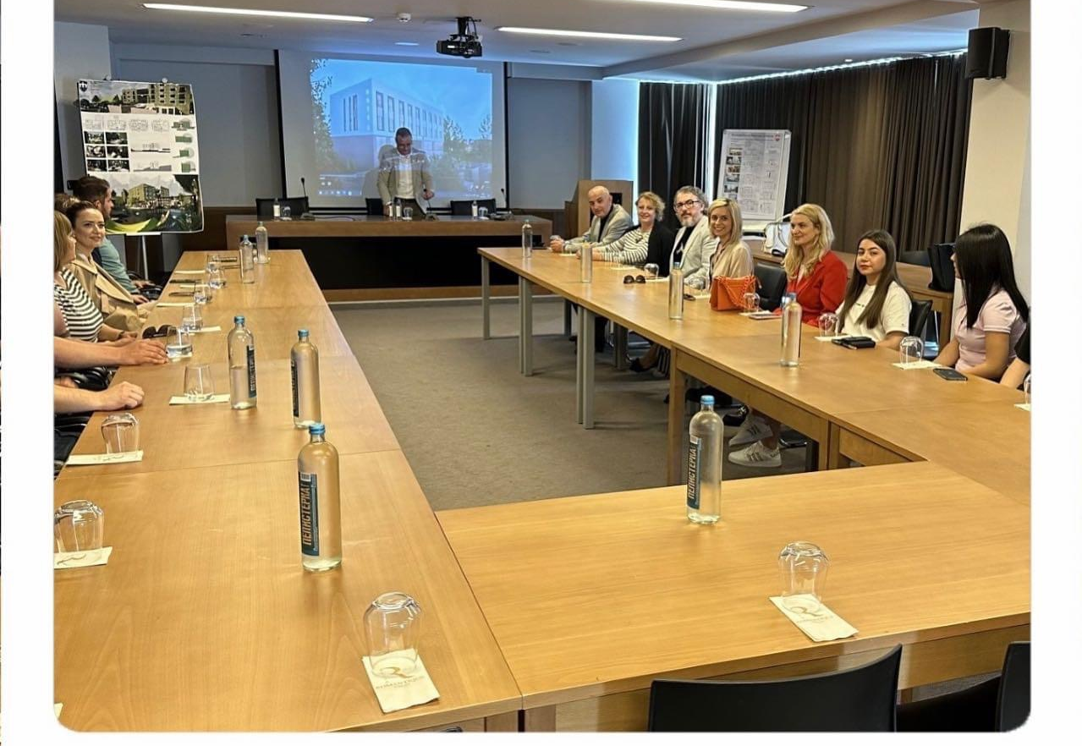
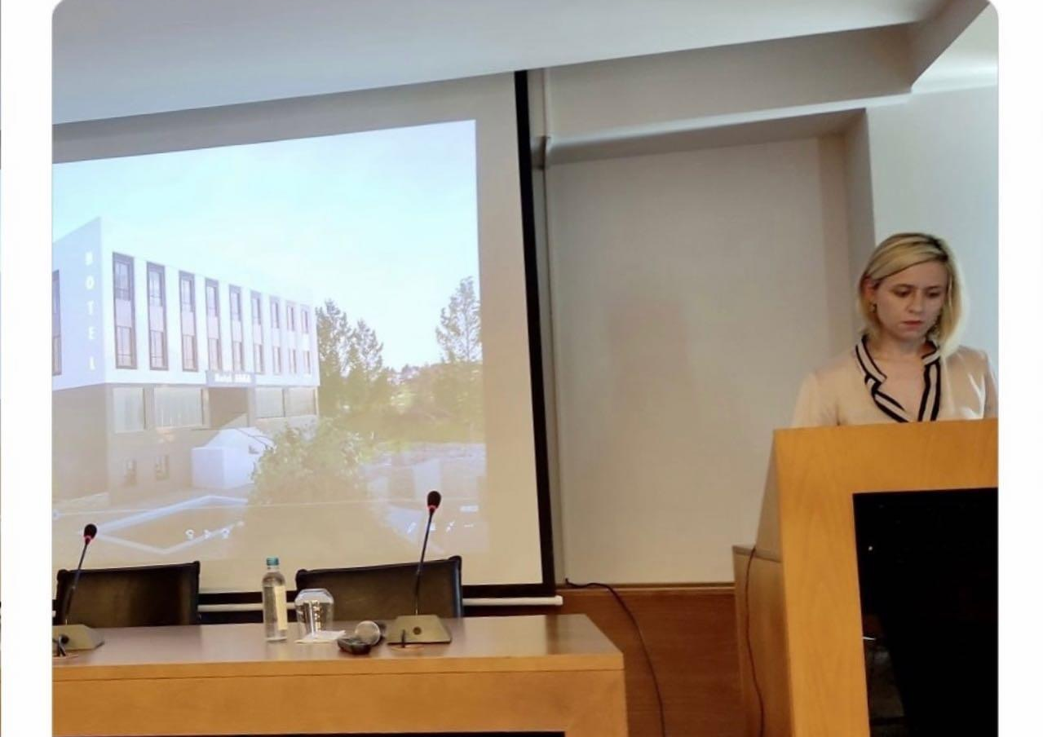
On May 29th 2023, the Project for the Reconstruction of the existing Hotel ,, Jaka” located in the central area of Star Dojran was presented to the competent authorities and the general public in the Municipality of Dojran, made by architecture students from the Department of Architecture, Faculty of Engineering under the mentorship of Prof. Dr. Aleksandar Andovski and Asst. MSc. Nadica Angova Kolevska, a project originally inspired by the needs of the citizens living in the municipality. The Vice-Rector for promotion at the University, Prof. Dr. Aleksandra Ristovska as well as the Dean of the Faculty of Engineering, Prof.Dr.Delcho Leskovski fully supported the event with their presence.
Following the schedule of guest speeches created by the municipality, the Vice-Rector for promotion at the University, Prof. Dr. Aleksandra Ristovska, as well as the academic staff of the Department of Architecture, addressed the audience expressing their immense gratitude to the Mayor of the Municipality of Dojran Mr.Ango Angov for the assigned responsibility and the opportunity to implement this project, with the hope that such initiatives and collaborations will continue in the future.

Slide 20

'XIV YOUTH SPRING SALON
At the group competitive exhibition 'XIV Youth Spring Salon,' held at the National Gallery of Macedonia, between educational institutions for art and design, IBU participants won 5 awards:
Prof. Srdjan Micic for the best art teacher
Arta Limani, first place in all categories
Hristina Georgieva, first place for the collection
Elena Ilievska, second place for the collection
Sare Qerimi, third place for the collection
We congratulate them all!

Slide 21
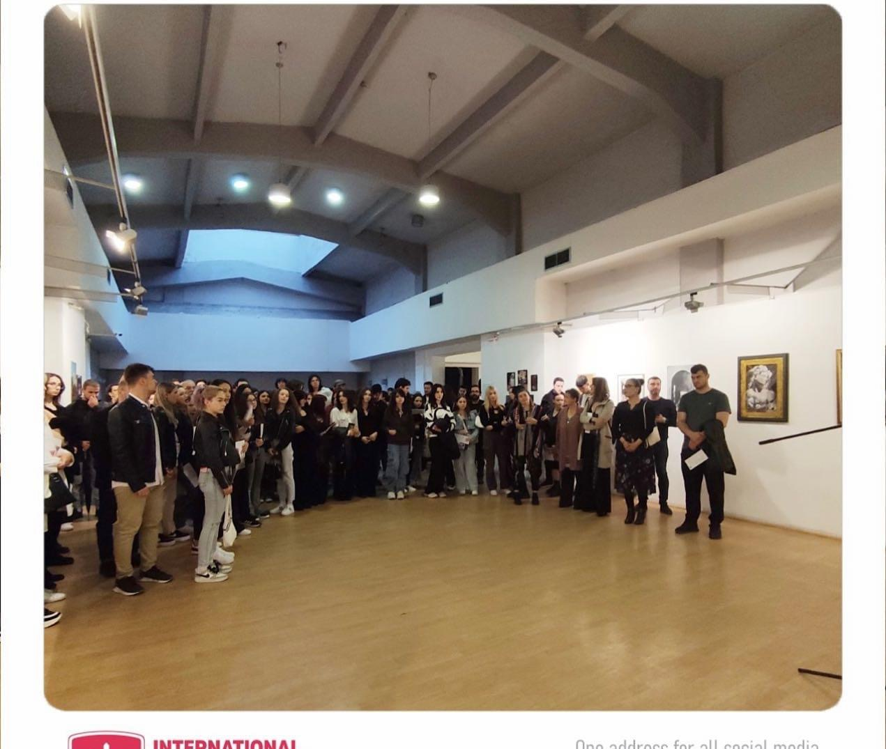
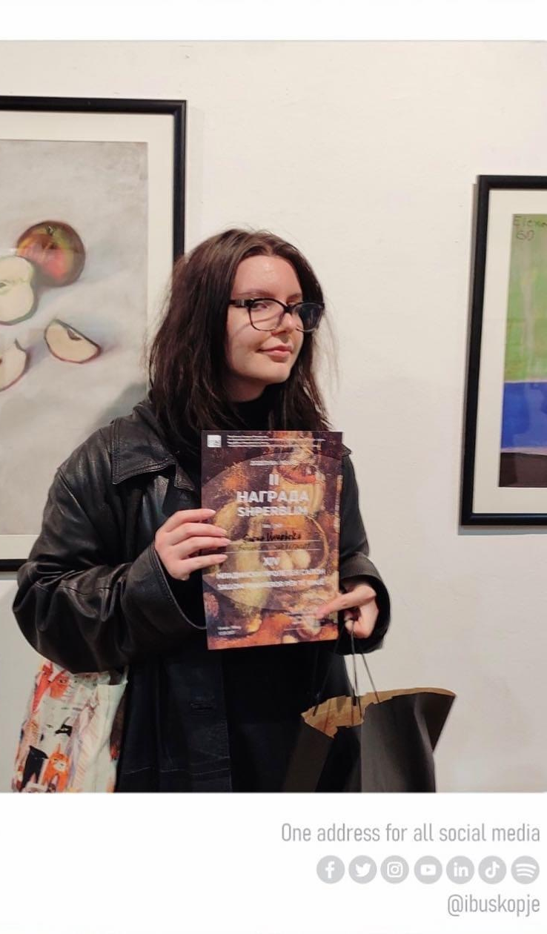
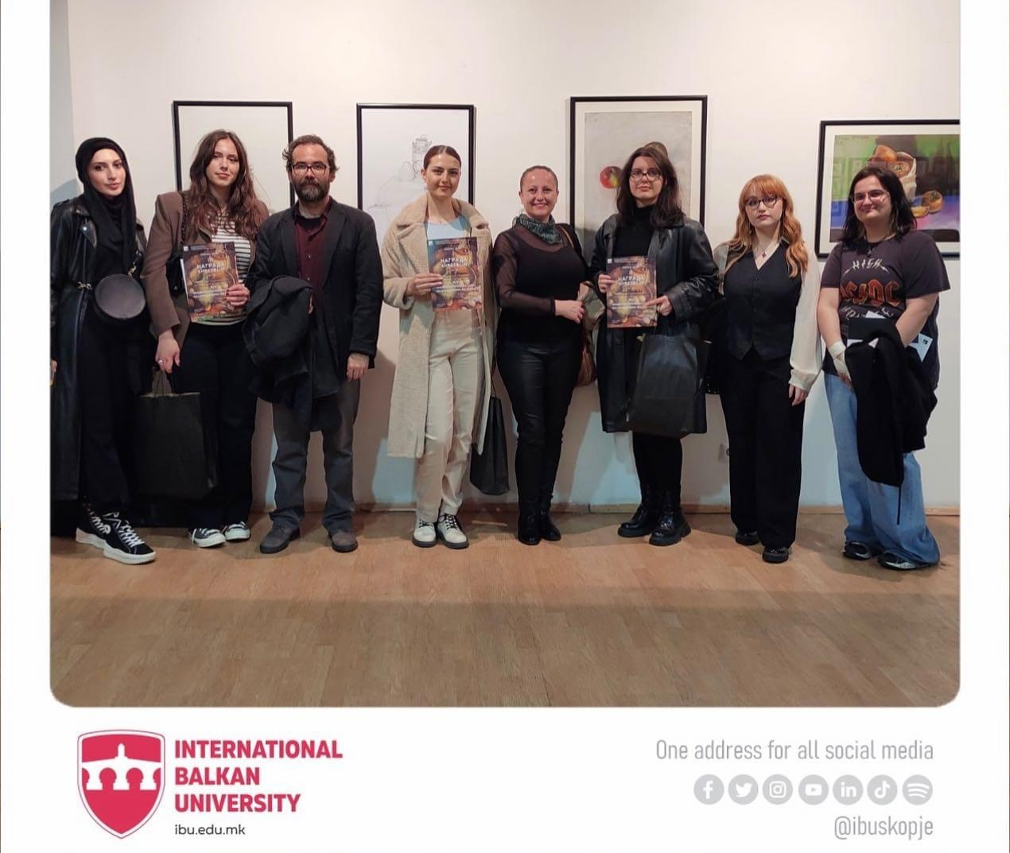



Slide 22
HIGHSCHOOL VISITS AND STUDENTS
CLASS ACCTIVITIES
Field classes in Photography
Monday, 28th of November,
Students from Graphic design, Visual Arts and Fashion design department had a field trip class with Photography 1 course at canyon “Matka”, with Assistant Nazli Can. The main purpose of today lecture was to learn the basics in composition as essential base of visuality, as well as experience with photography in nature.

Slide 23


FIELD CLASSES IN PHOTOGRAPHY
Field classes in photography are specialized workshops or courses created to offer hands-on learning experiences in authentic environments. These courses are especially helpful for budding photographers who want to improve their abilities, learn useful information, and obtain a deeper grasp of taking pictures in diverse settings.
The major goal of field classes is to go beyond theoretical knowledge and provide students the skills they need to implement what they've learned in the real world. Professional photographers or knowledgeable instructors who can provide each student with individualized comments and insightful commentary frequently lead these sessions.

Slide 24
Field classes in the printing house "Focus Print"
Tuesday, 29th of November,
Students from the 4th year of the Graphic design department had field classes in the course Publication design at the printing house "Focus Print", with prof. Vladimir Gjorgjieski. The primary target of today's lecture was to learn the process of printing books and publications.

Slide 25



On-location Training, workshop in the printing company Focus Print, with prof Vladimir Georgieski

Slide 26

HIGH SCHOOLS VISITS
On the 7th of April, the Faculty of Art and Design visited the high school for art Sh.M.P.K. "Gjoce Stojceski" in Tetovo. The purpose of the visit was to promote the faculty's programs and to establish connections with the high school for potential collaborations.
The team from the Faculty of Art and Design was warmly welcomed by the school's president, who expressed his interest in working with the faculty.
After the meeting, the team from the Faculty of Art and Design visited the art classes for fashion design and interior design. They were impressed by the students' creativity and skills demonstrated through their artwork.
Visit to High School " Dobri Daskalov" in Kavadarci.
On 13.04.2023 a team from the faculty of Art and Design visited the high school to promote the International Balkan University and discuss about the future of the students. The team consisted of Professor Dzemil Bektovic and assistants Nazli Can and Aleksandra Jovanovska.
During the successful visit a Memorandum of Cooperation was signed for creating future projects together and organizing visits to the IBU campus in Skopje.
On Tuesday 11th of April 2023, the Faculty of Art and Design with Assoc.Prof. Laze Tripkov, Asst. Nazli Can and student assistant Aleksandra Jovanovska, presented the variety of study programs that IBU offers in all areas of their educational process to 4th year students in the high school "Braka Miladinovci" from Skopje.
During the visit, a Memorandum of Cooperation was signed between the International Balkan University and the high school "Braka Miladinovci.
Special thanks to the Director of the High school who provided us with their support during the realization of the presentation process.
High School of Art and Design ‘Lazar Licenoski’ hosted Assoc. Prof. Dr. Laze Tripkov to present International Balkan University and to discuss about the opportunities for the future art students. The professor presented the department of Graphic Arts, Graphic Design, Fashion Design and Multimedia.
On Thursday 4th of April 2023, a representative group from the Faculty of Art and Design promoted the study programs at IBU to 4th year students in the high school "Pance Arsovski" in Skopje.

Slide 27










HIGH SCHOOLS VISITS

Slide 28
Workshop "Fair of Creative Industries“
On the 3rd and 4th November 2022 in the premises of City mall, a workshop was held "Fair of Creative Industries". With this event our students were introduced to the techniques of working in the field of print making and had the chance to view and study other artists prints and see other techiques of creating prints. Few of our students from the Faculty of Art and Design participated and displayed their printed works.

Slide 29




WORKSHOP FAIR OF CREATIVE INDUSTRIES

Slide 30




EXHIBITION AT KORA GALLERY
CRITICAL METHODOLOGIES #2 VISUAL COUNTER-INTIMACIES AND SPECULATIVE REALITIES By Andrea Corrales
Erasmus + STAFF MOBILITY FOR TEACHING

Slide 31



Slide 32

Europe House Skopje,
On February 2nd in Europe House Skopje, the first call for artists from the open within the framework of the development program for artists of the European Investment Bank was presented. Faculty of art and design was invited to participate on the presentation for this program.
The program offers the opportunity for emerging artists (born after January 1, 1988 in the Western Balkans, Turkey, Moldova or Ukraine) to spend 3 months at the Cité internationale des arts in Paris, France.

Slide 33



EUROPE HOUSE SKOPJE

Slide 34

Kindergarten in Usje, SKOPJE MINICIPALITY
On 31st January there was a meeting with the ambassador of the Federal Republic of Germany, Otto Graf. At this constructive and friendly meeting today, we exchanged experiences and defined the possibilities for new spheres in which joint cooperation is possible.
It is nice when there is support, especially in such large projects where we made a big investment from our own funds - an inclusive kindergarten in a place where there was never one.
With such moves, we are sending a clear message that the improvement of the conditions and thus enabling the support of the positive development of the youngest population is a common strategic determination.
I hope so, and that is exactly what we agreed on at today's meeting with the acting Ambassador Graf, that projects of this and similar nature will have the support of the Federal Republic of Germany in the period ahead.
Speaking of the new kindergarten in Usje, I also want to thank the students from the Faculty of Art and Design at the International Balkan University from Skopje, who, under the mentorship of their professors, worked on the visual design of this first inclusive kindergarten in the territory of the city of Skopje.

Slide 35






KINDERGARTEN USJE

Slide 36

Regional Conference organized by Ministry of Labor and Social Policy
Our students and young academic staff members from the IBU Faculty of Art & Design, accompanied by the Dean - Prof. Dr. Aleksandra Ristovska, gave a special contribution to the Regional Conference organized by Ministry of Labor and Social Policy titled "Loudly and courageously moving the borders", that. happened on the 30th and 31st March in Skopje.
In the spirit of the main topic, our artists visually expressed the messages and conclusions from the various panels that are being held and attracted the attention of all attendees.
At the margins of the Conference, Prof. Dr. Ristovska had a pleasant meeting with the Minister of Culture, Mrs. Bisera Kostadinovska Stojchevska and shared ideas about future collaboration.
Very happy and thankful for this fruitful cooperation with the Ministry of Labor and Social Policy led by Ms. Jovana Trenchevska, aimed towards creating a more inclusive and equal society based on the common values, embracing diversities as a strength.

Slide 37






REGIONAL CONFERENCE ORGANIZED BY MINISTRY OF LABOR AND SOCIAL POLICY

Slide 38

15th of June academic staff and students from the Faculty of Art and Design were invited by the Minister of Labor and Social Policy in the Government of the Republic of North Macedonia, Yovanka Trencevska for delivering a certificate of appreciation to Prof Aleksandra Ristovska, Prof. Srdjan Micic, Asst.Nazli Can, St Ast. Dielza Sopi and the students Arta Limani and Sare Qerimi.

Slide 39






DISTRIBUTION OF CERTIFICATES OF APPRECIATION BY MINISTER OF LABOR AND SOCIAL POLICY
IN THE GOVERNMENT OF THE REPUBLIC OF
NORTH MACEDONIA YOVANKA TRENCEVSKA

Slide 40







Under the moto #LeaveTrace launched in seven cities across Macedonia in association with the Institute for Good Governance and Euro-Atlantic Perspectives, the Ministry of Labour and Social Affairs and the Faculty of Art and Design continued with the cultural initiative in Bitola on 15th July and in Dojran on July 22. This program aims to combat intolerance and discrimination as a component of the joint project between the European Union and the Council of Europe known as the "Horizontal Instrument for the Western Balkans and Turkey."
Participants in the event shared their own narratives, which inspired others. The Faculty of Art and Design was represented by notable students Arta Limani, Ebrar Bekir, and Elena Dimchevska, all of whom displayed their creative works.
This event aims to promote and showcase various aspects of culture, arts, and traditions in different locations.

Slide 41













Slide 42

On July 21, International Balkan University, with the study program of Fashion Design (FAD), were invited to participate in Fashion Week in Sibiu, Romania. At this fashion event several universities from the region participated with their own fashion collections made by the students. The students from IBU that participated are: Marigona Rahmani, Rinesa Ahmeti, Hava Jahja, Sureja Jakupi, Sara Said, Esra Fazliji, Oya Osman, Hristina Gjorgjieva, Berna Ahmed, Luna Avramovska and Ebru Kalinka.Everything that is created in nature ends back in nature and vice versa. The students of first and second year of fashion design were inspired by nature in an aesthetical and practical sense. First year students upcycled old clothes and gave them a second chance to be trendy again. With this method, students are raising awareness to rethink how we treat clothes and trends today. Students of second year were inspired by natures shapes and forms, finding ways to intemperate and incorporate nature through design.
After 14 years in which Feeric Fashion Week / @feericfashionweek provided the catwalk of the world’s most creative emerging and established fashion designers in Sibiu, Transylvania, the festival takes a step forward towards increased sustainability in international fashion.

Slide 43







Slide 44
Organizators:
Students from Faculty of Art and Design
Dean: Prof. Dr. Aleksandra Ristovska
Ast. Prof. Vladimir Gjorgieski
Prof. Srdzan Micic
Prof. Laze Tripkov
Prof.Dr. Dzemil Bektovic
Ast. Nazli Can

